Slide 1
Palace of the Parliament
Benjamin Pervan

Slide 2
Location of Palace of the Parliament, and general facts about it
Technical details
History of Palace of the Parliament
Interesting facts

Slide 3
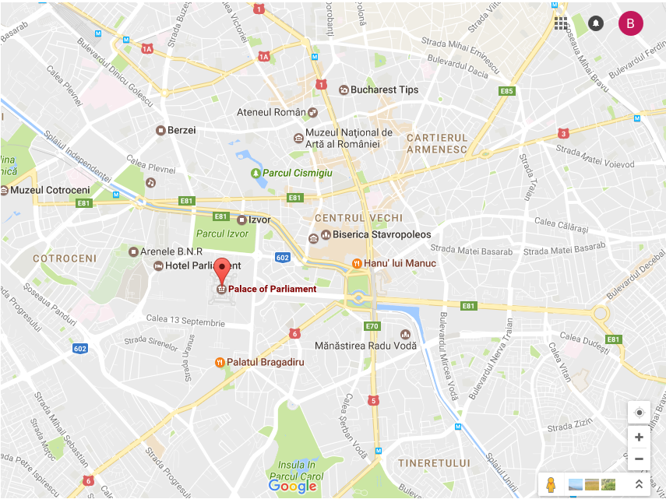
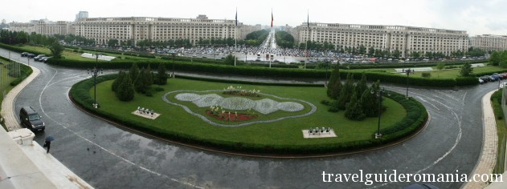
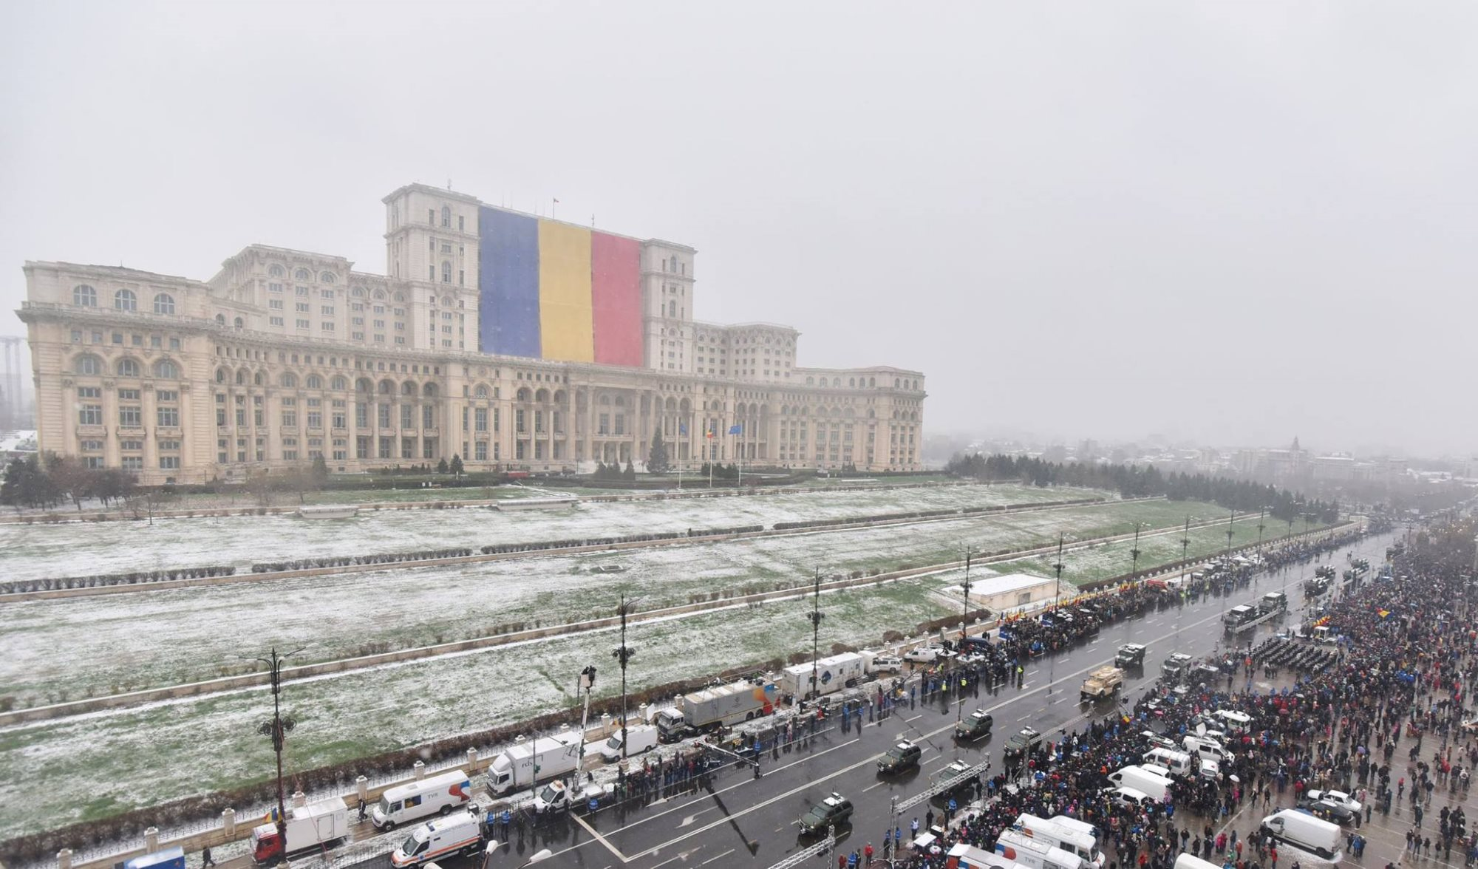
Location of Palace of the Parliament
The building of the Palace is located in the central part of Bucharest.
Address: Calea 13 Septembrie 1
It is framed by Izvor Street to the west and northwest, United Nations Avenue to the north, Liberty Avenue to the east and Calea 13 Septembrie to the south.
Architectural style: late interpretation of neoclassical architecture.
Due to its impressive endowments, conferences, symposiums and other events are organised by state institutions and international bodies, but even so about 70% of the building is empty.
Height: 84 m
240 m long, 270 m wide
12 floors, 365000 m² floor area, 66,000 m² ground area

Slide 4
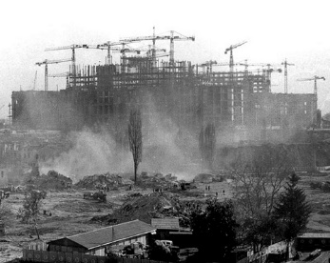
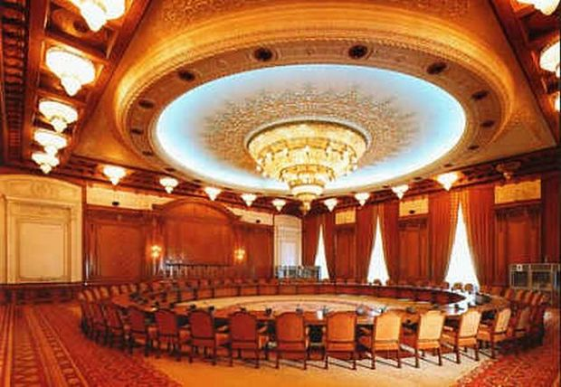
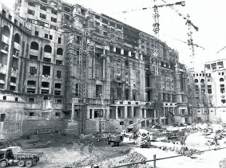
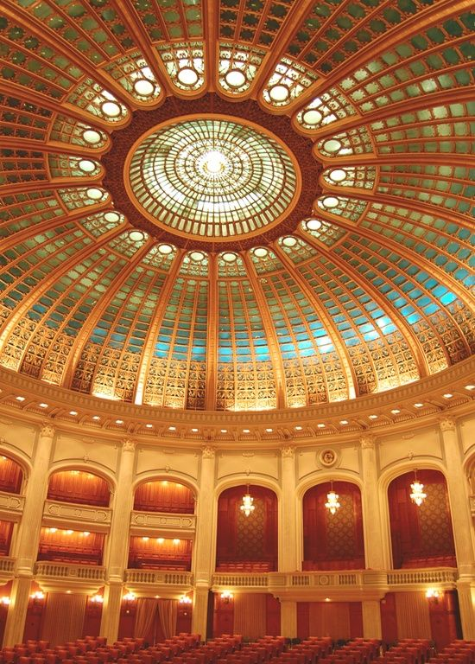
Technical details
The construction of the Palace began in 1984 and should have been completed until 1986, but even now it is not fully finished.
It was completed in 1994.
Only 400 rooms and two meeting rooms are finished and used, out of 1,100 rooms.
The building has eight underground levels.
The building has a developed area of 365,000 m², being the world's second largest administrative building.
The building of the Palace of the Parliament sinks by 6 mm each year.
The building was constructed almost entirely of materials of Romanian origin.
The cost of heating and electric lighting alone exceeds $6 million per year, as much as a medium-sized city.

Slide 5
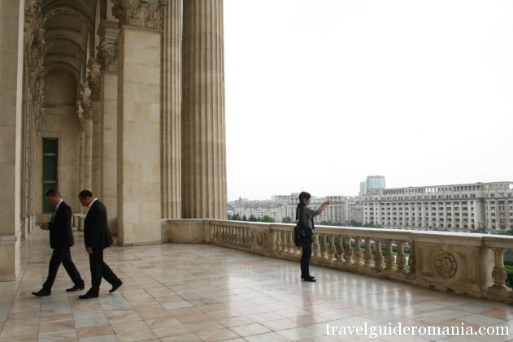
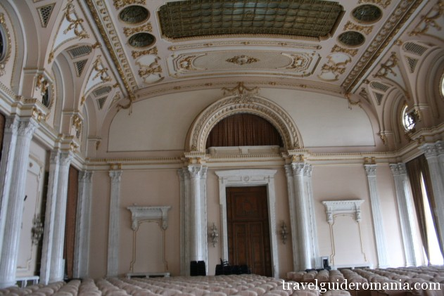
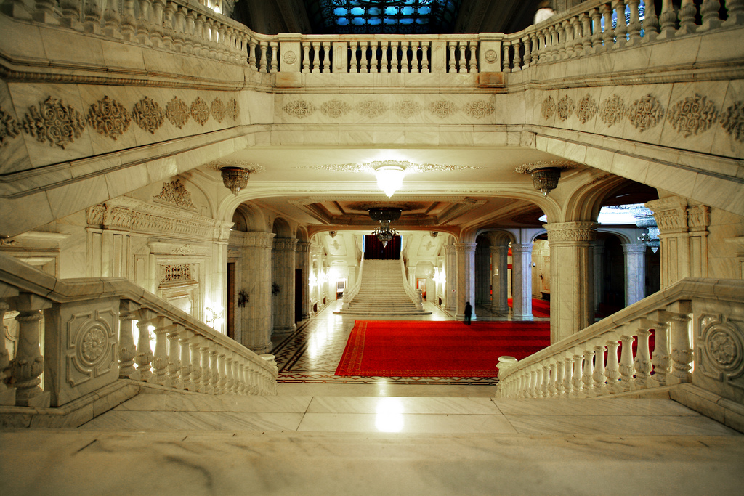
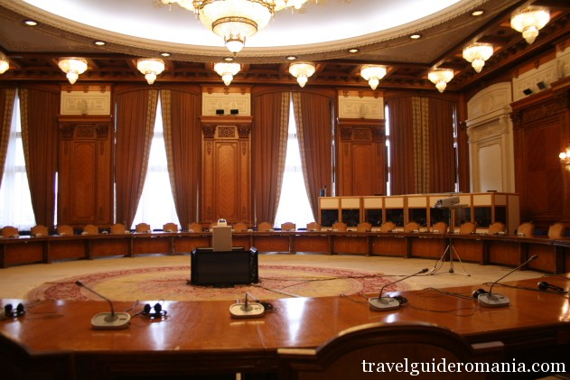
13th of September Entrance hosts the most magnificent staircase in the Palace, inspired by The Winter Palace’s staircase in Sankt Petersburg.
Human Rights Chamber is decorated with oak tree and has the second largest/heaviest chandelier in the Palace, weighing 2 tons.
Alexandru Ioan Cuza Chamber is one of the most important and towering chamber of the Palace. It is 20 m high and a has a surface of 2040 m2.
The Balcony facing Piața Unirii

Slide 6
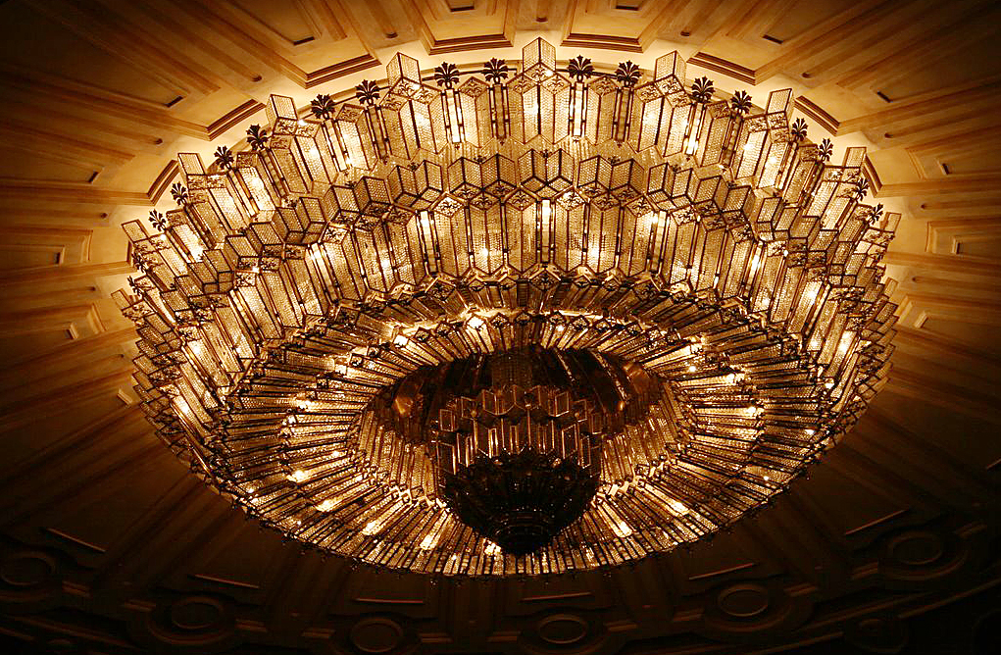
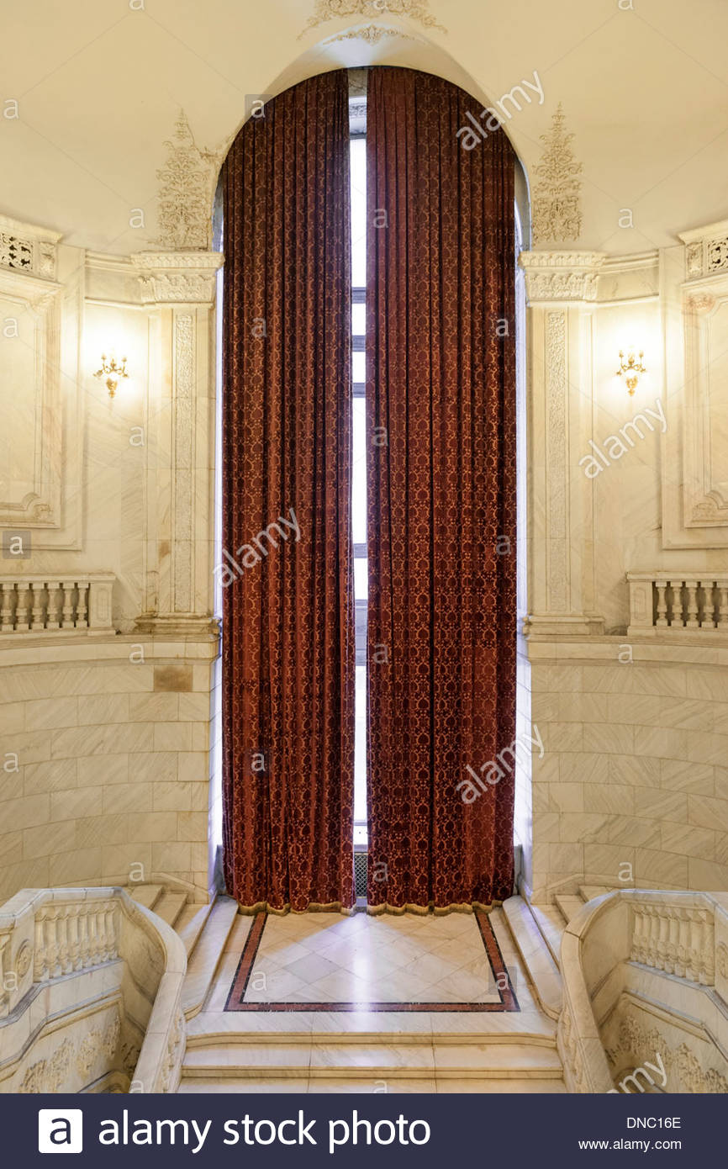
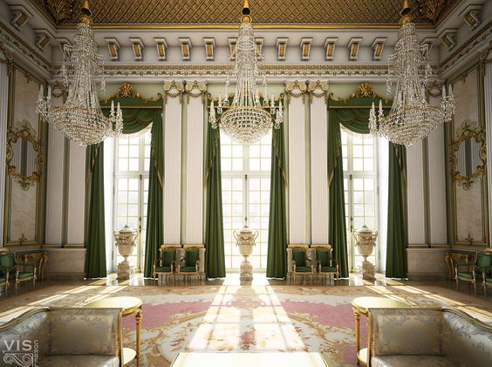
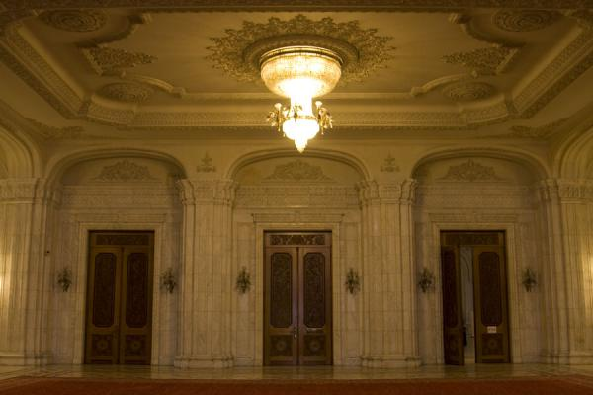
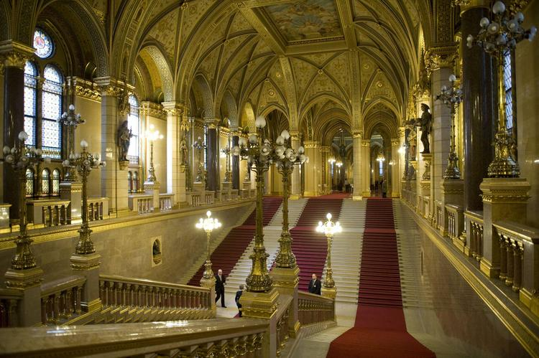
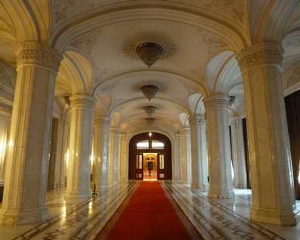
Materials used:
1.000.000 m³ of marble
3,500 tonnes of crystal – 480 chandeliers,
1,409 ceiling lights and mirrors were manufactured
700,000 tonnes of steel and bronze for monumental doors and windows, chandeliers and capitals
900,000 m³ of wood (over 95% domestic) for parquet and wainscotting, including walnut, oak, sweet cherry, elm, sycamore maple
200,000 m² of woolen carpets of various dimensions (machines had to be moved inside the building to weave some of the larger carpets)
velvet and brocade curtains adorned with embroideries and passementeries in silver and gold

Slide 7
History of Palace of the Parliament
After the earthquake of 4 March 1970, Nicolae Ceaușescu started a reconstruction plan of Bucharest.
It was an ambitious project of Ceausescu,which began in 1978.
For its construction was organized a contest, won by Anca Petrescu.
The building was erected on the site of some monasteries that were demolished.
Between 20,000 and 100,000 people worked on the site, sometimes operating in three shifts.
Thousands of people died working at the People's House.

Slide 8
In 1989 building costs were estimated at $1.75 billion, and in 2006 at €3 billion.
Since 1994 the building hosts the Chamber of Deputies
Since 2004 the Romanian Senate is headquartered in the building.
National Museum of Contemporary Art opened in 2004 inside the west wing of the Palace.
In 2008, the Palace hosted the 20th NATO summit.
In 2010, politician Silviu Prigoană proposed re-purposing the building into a shopping centre and an entertainment complex.

Slide 9
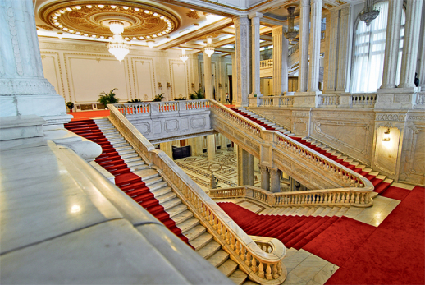
Interesting facts
It is bigger than Cheops’ Pyramid.
400 contributing architects lead by a 28 years-old woman
Initially it was named “House of the Republic”
Mysterious Tunnels
It is the heaviest building on Earth
Every chamber has a perfect echo, because when Ceausescu wanted something, he clapped.
The palace's Union Hall features two large spiral staircases
In 1990, Australian business magnate Rupert Murdoch wanted to buy it.

