Slide 1
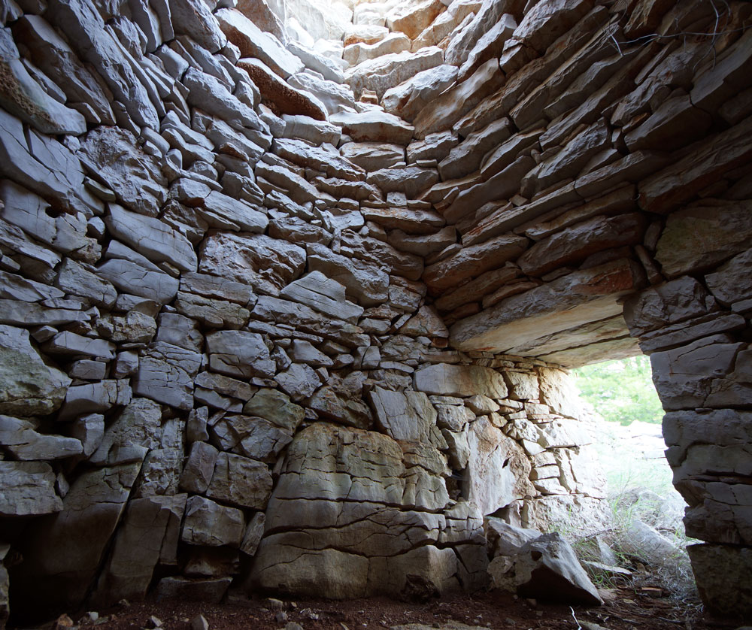
Traditional building
Croatia

Slide 2
Croatia is a country that is rich in traditional building
-it’s national and handed-down and popular
-skill of building was handed down
-Until the end of the 18th century the village or rural house was modest indeed
-Single space house with a rectangular ground plan
-Much of the valunable traditional building no longer exist
-lasted until World War II
-industralisation,urbanisation and electrification became imperatives

Slide 3
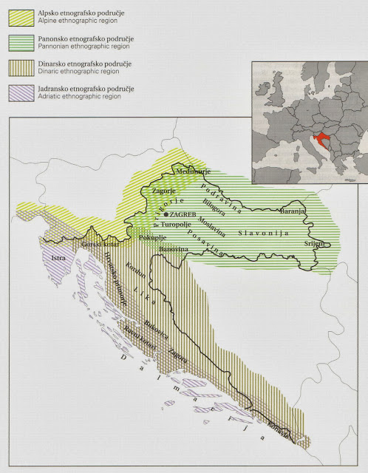

Slide 4
In the traditional and popular arhitecture lies the substance of the arhitecture and culture of a people and the treasure house of humanity is composed of the richness of their diversities . Munjaković

Slide 5
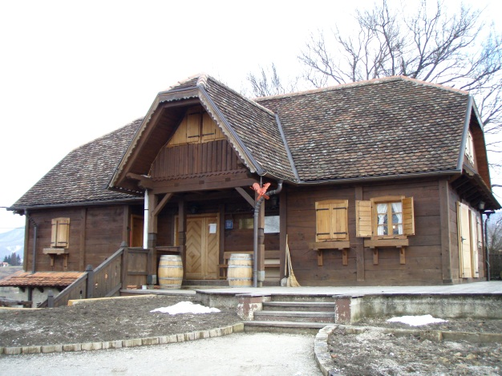
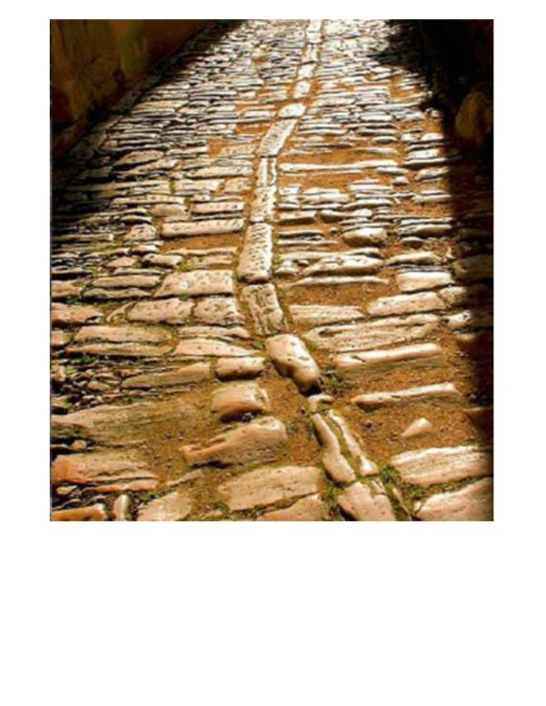
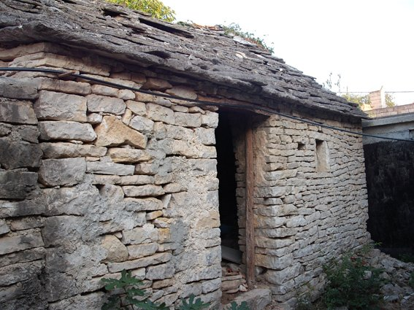
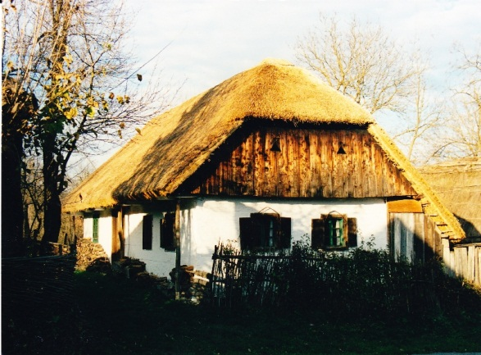
The material (traditional building)
ecological
Karst area (Adriatic zone)
The region of Lika ,Kordun...
Slavonija
Baranja

Slide 6
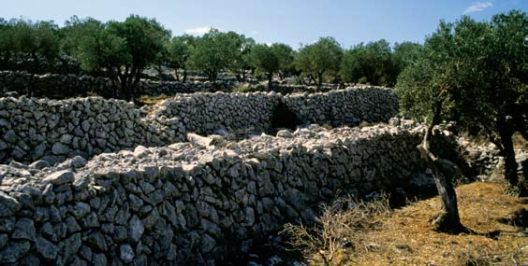
In the Karst area the Croats came upon building in stone:
Dry stone wall

Slide 7
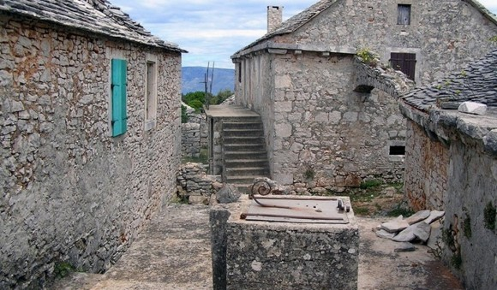
From the second half of the 19 th century ,bonding material started to be used (lime mortar,soli,clay) .

Slide 8
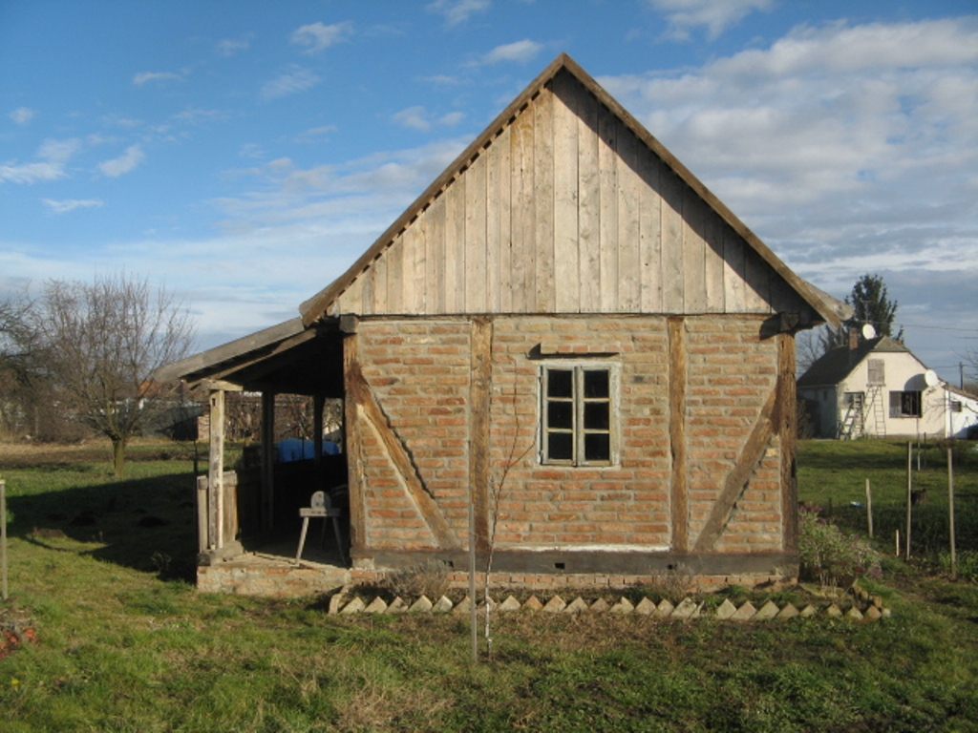
In Slavonia peasants got the material for the basic timber frame.
FILL :
wattle of withies covered on both sides
short pieces of wood
sun dried brick
fried brick

Slide 9
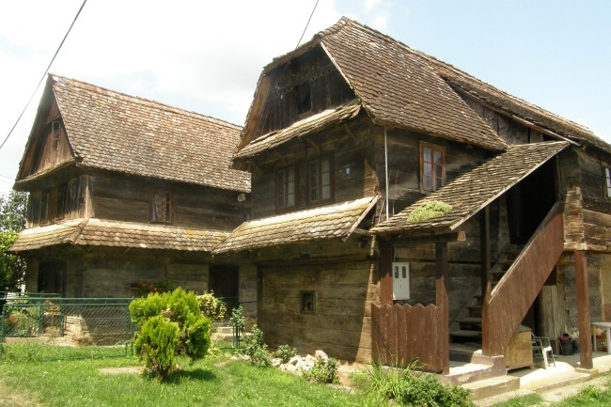

Slide 10
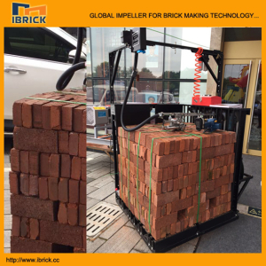
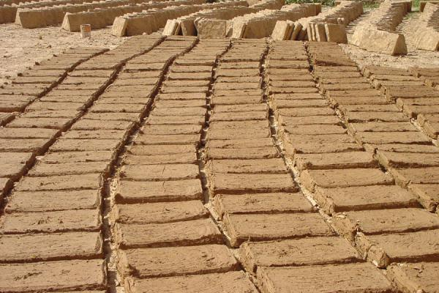
The material :
Čerpići (sun dried brick)
Opeka (fried brick)

Slide 11
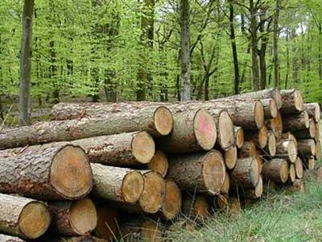
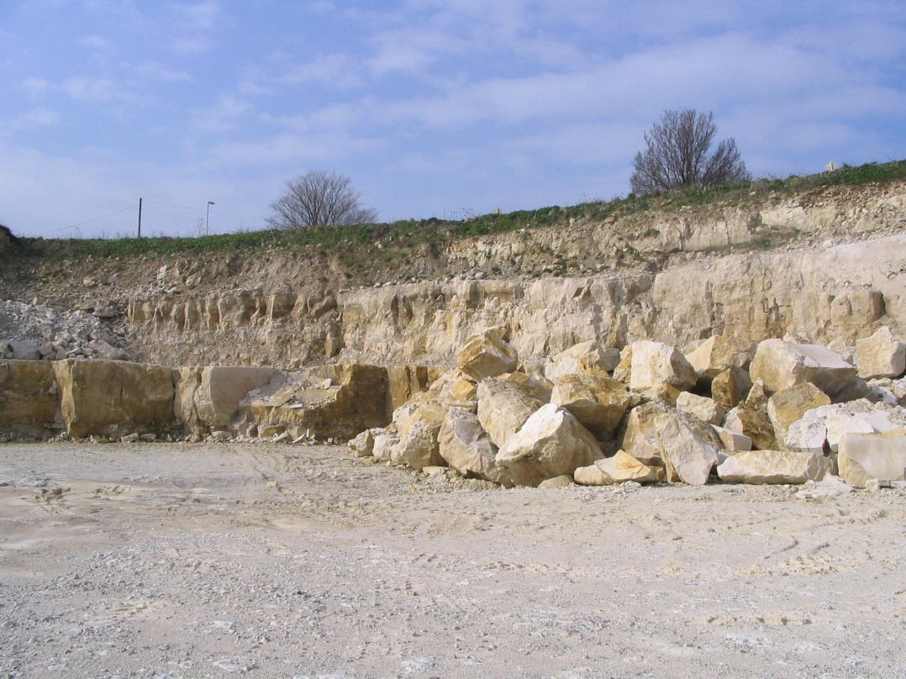
Stone Timber(oak,chestnut)

Slide 12
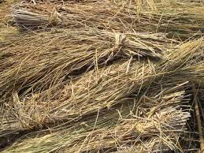
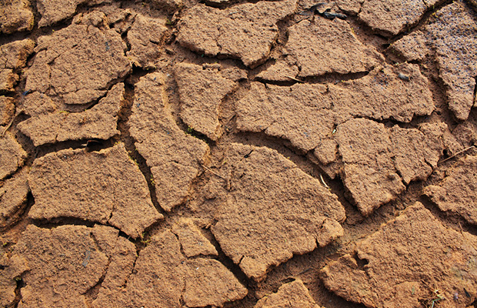
Straw Clay

Slide 13
The spatial development of the traditional house
HORIZONTAL :
-the single roomed house with the fireplace
-the fireplace was moved to the side
-two roomed house (room for sleeping)
-three roomed house (the kitchen in the centre)
Three –roomed house is the typical traditional house in Croatia .
VERTICAL:
-In the Pannonian there was no vertical development
-In Posavina,Moslavina and Pokuplje was vertical development
because of the floods
-In the Mediterranean space vertical development was result of
general progress

Slide 14
STRUCTURES
FOUNDATIONS:
-the structure to which in traditional building practice as much importance was attached as was required by the ground being built upon
-the foundation trenches were filed with stone
-large stones at distance of 2-3 meters
-wooden piles in the ground
- brick-built piles
- POCEKI (specially dimensioned oak beams)
-fried bricks( from the mid 19th century)

Slide 15
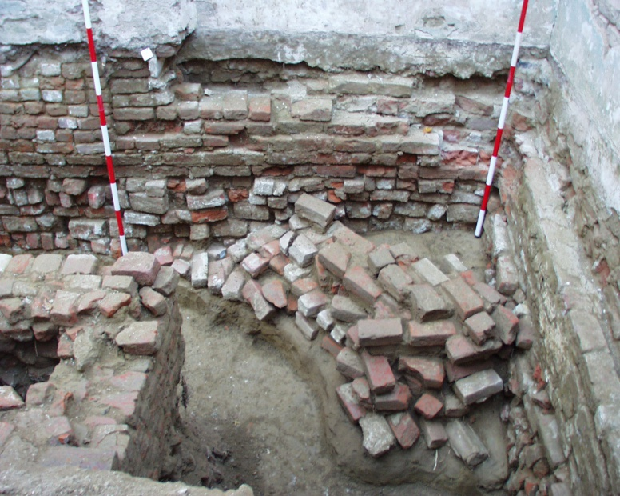

Slide 16
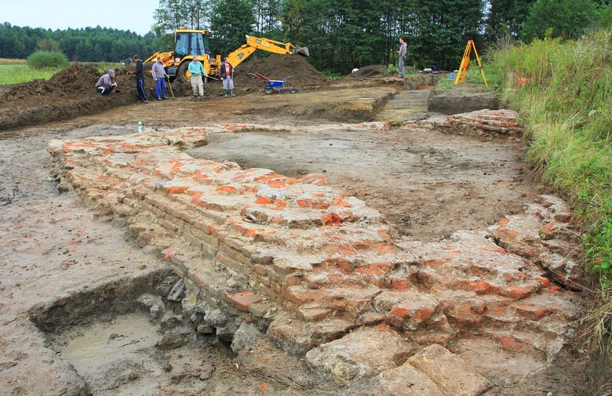

Slide 17
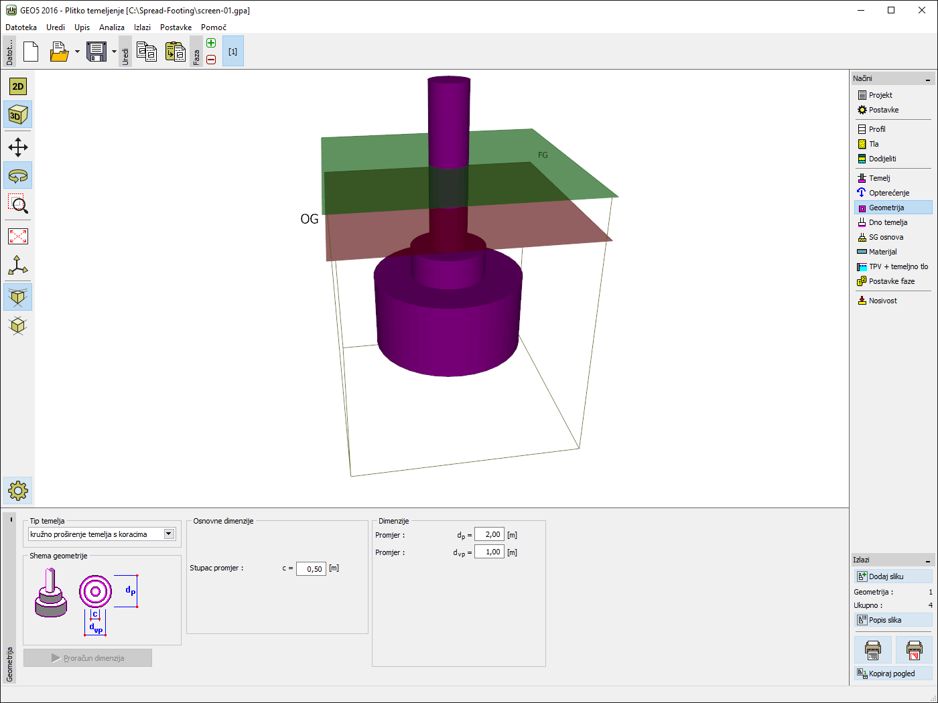

Slide 18
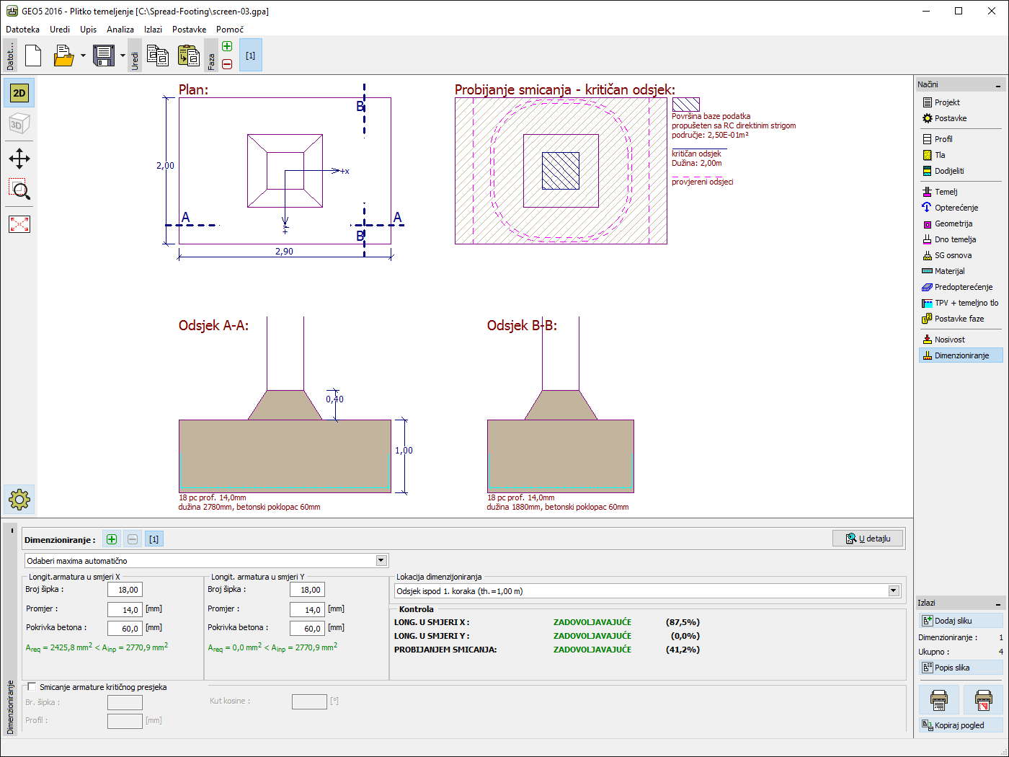

Slide 19
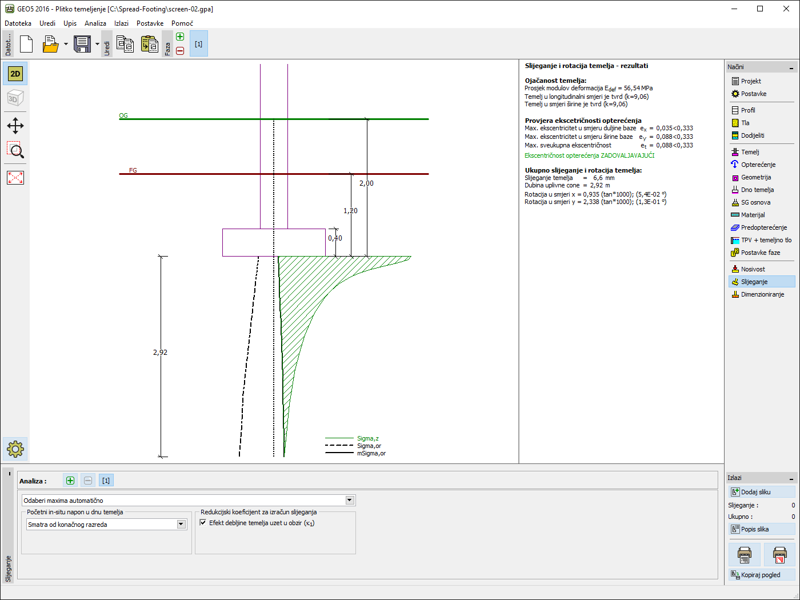

Slide 20
OUTER AND INNER WALLS :
-axe was only tool
-improvement was the making of planks
-round wooden dowels
-walls were built in sundried brick
-bonding material (clay)
-thermal characteristics were good
-damp was worst feature
CEILINGS:
-tram (ceiling joist)
-end of beam went on beyond the facade(because of the overlaps)
On these beam usually the year of the building of the house or the name of owner were craved .

Slide 21
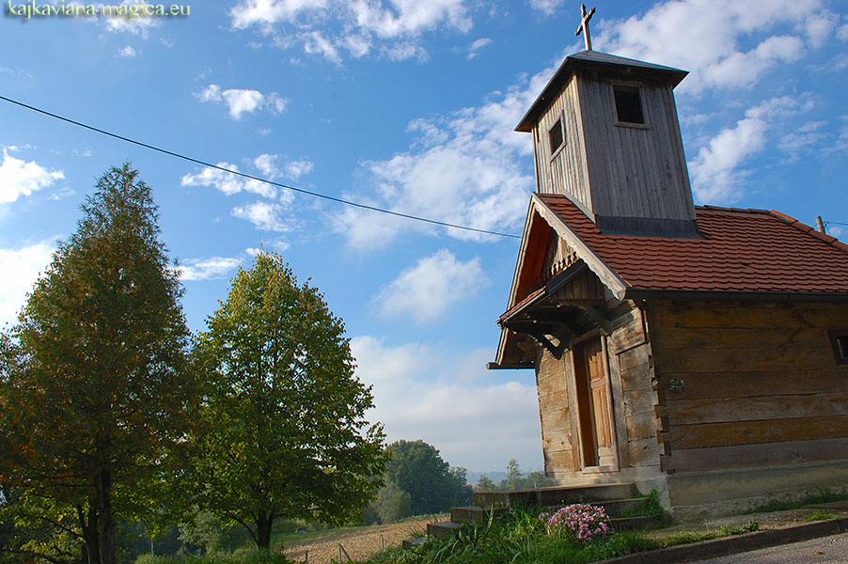

Slide 23
ROOF CONSTRUCTION
Roofing structures were very simple
These are on the whole of wooden rafters of slightly longer spans the triangle of rafters being braced with a collar tie .
-more complex constuctions built on the whole trusses
The shapes of roofs depends on the climate and kind of roofing material
-Vegetable covering (shingles ,straw,rush thatch) are more susceptible to getting wet
-Stone slabs ,slates , tiles and barred tiles are less susceptible to wetting

Slide 24
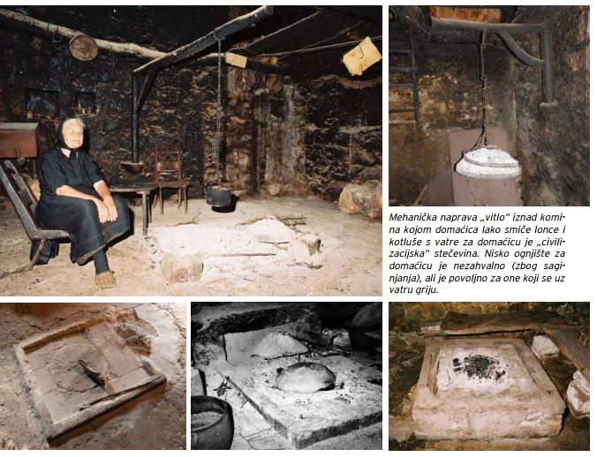
Building elements of the traditional house
Fireplaces :

Slide 25
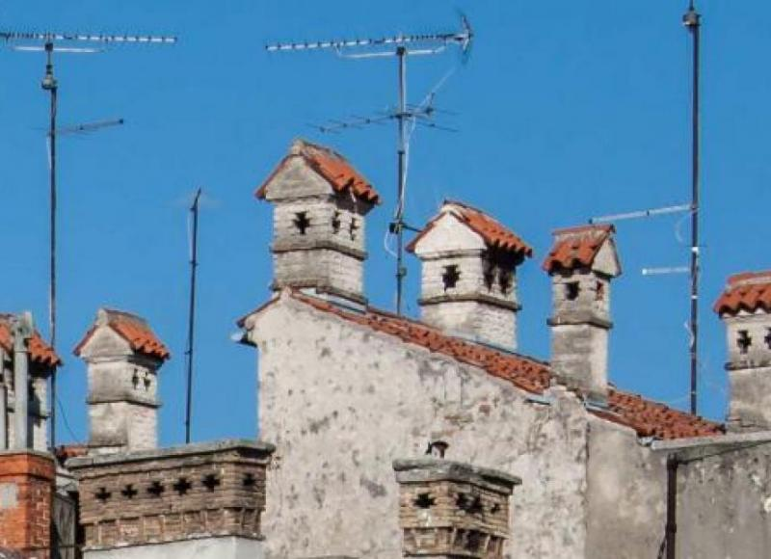
Chimneys

Slide 26
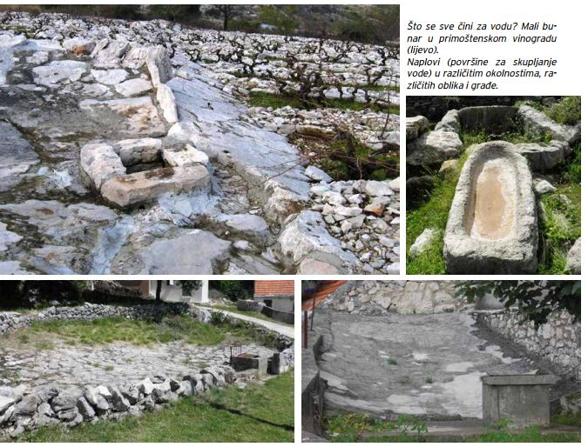
Wells and cisterns

Slide 27
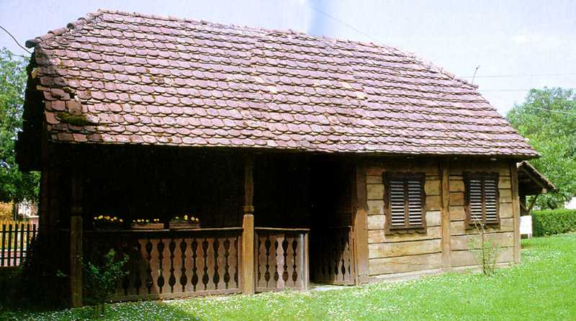
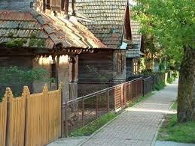
Porches

Slide 28
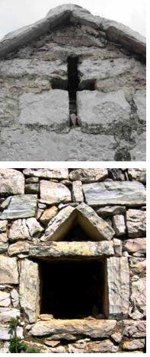
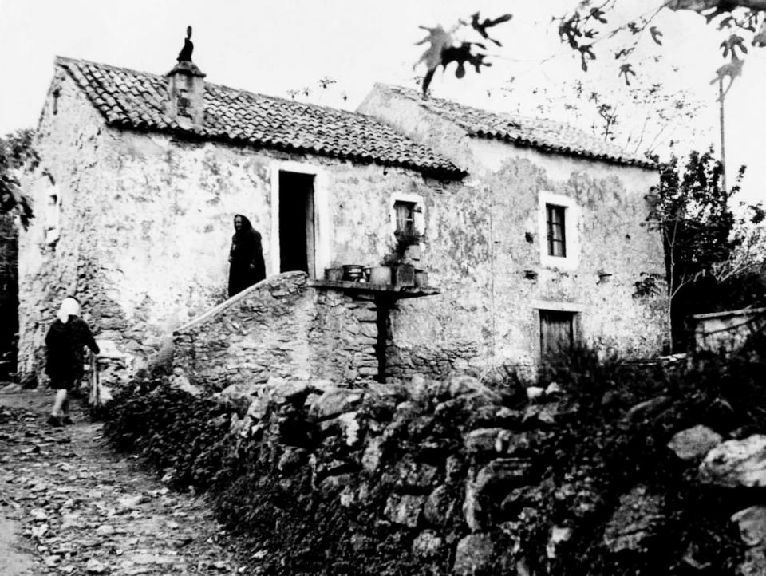
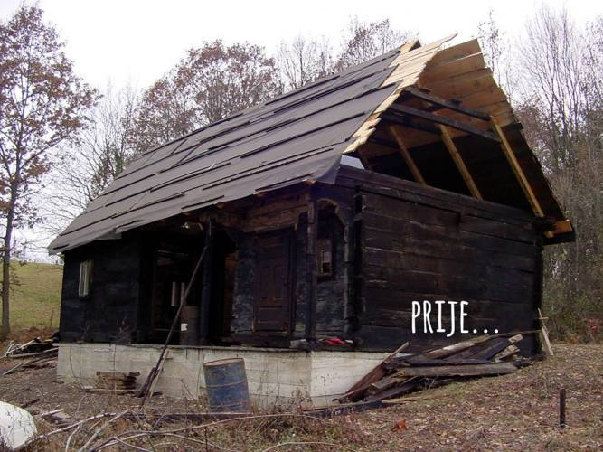
Doors and windows

Slide 29
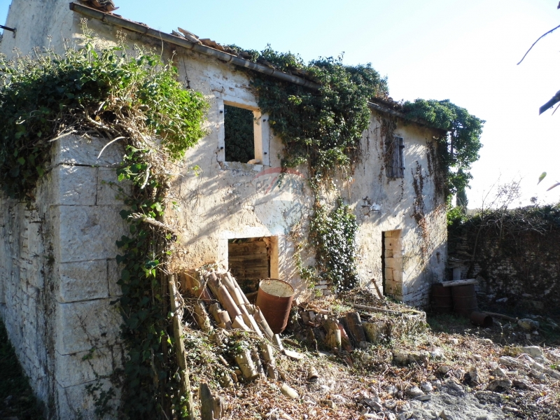

Slide 30
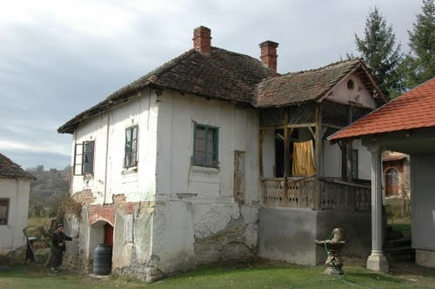

Slide 31
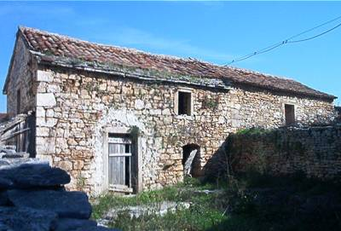
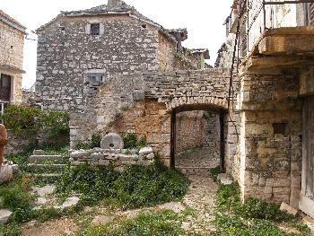

Slide 32
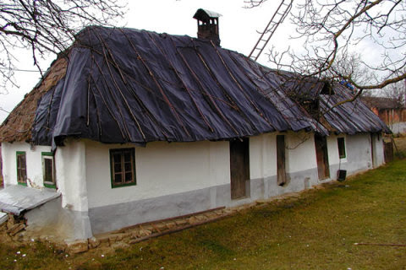

Slide 33
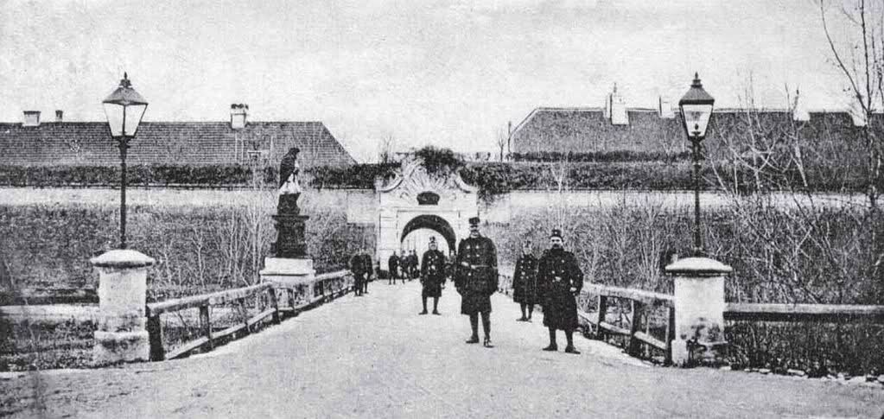

Slide 34
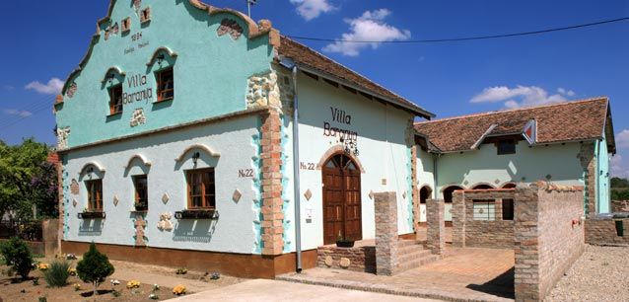

Slide 35
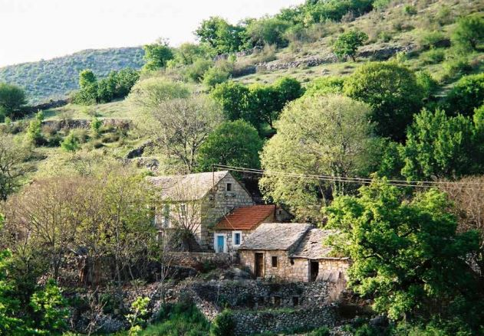

Slide 36
