Slide 1
Chesapeake Bay Bridge
Virginia, USA

Slide 2
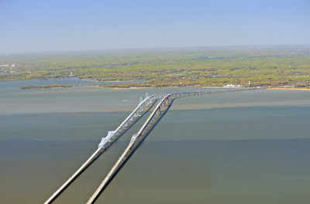

Slide 3
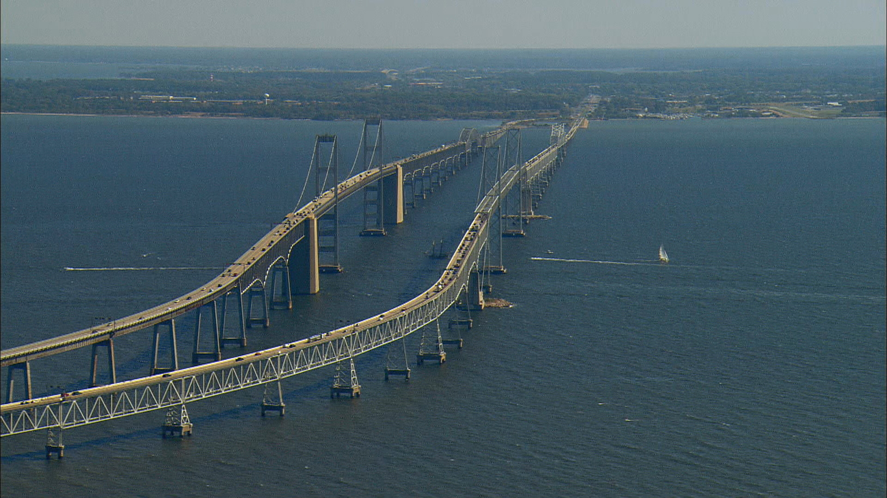

Slide 4
Problems
Funds
Busy shipping strait
High traffic shipping channel

Slide 5
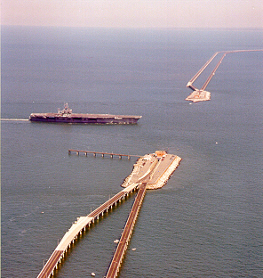
Design solution

Slide 6
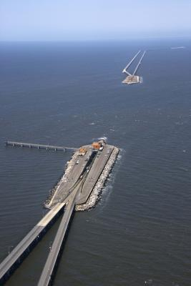

Slide 7
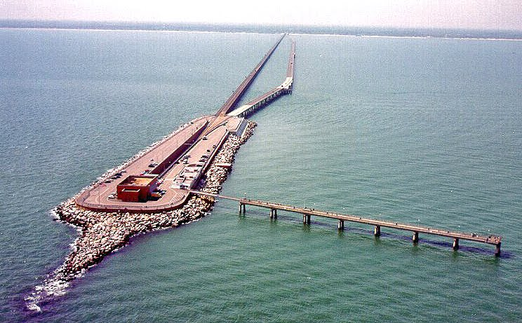

Slide 8
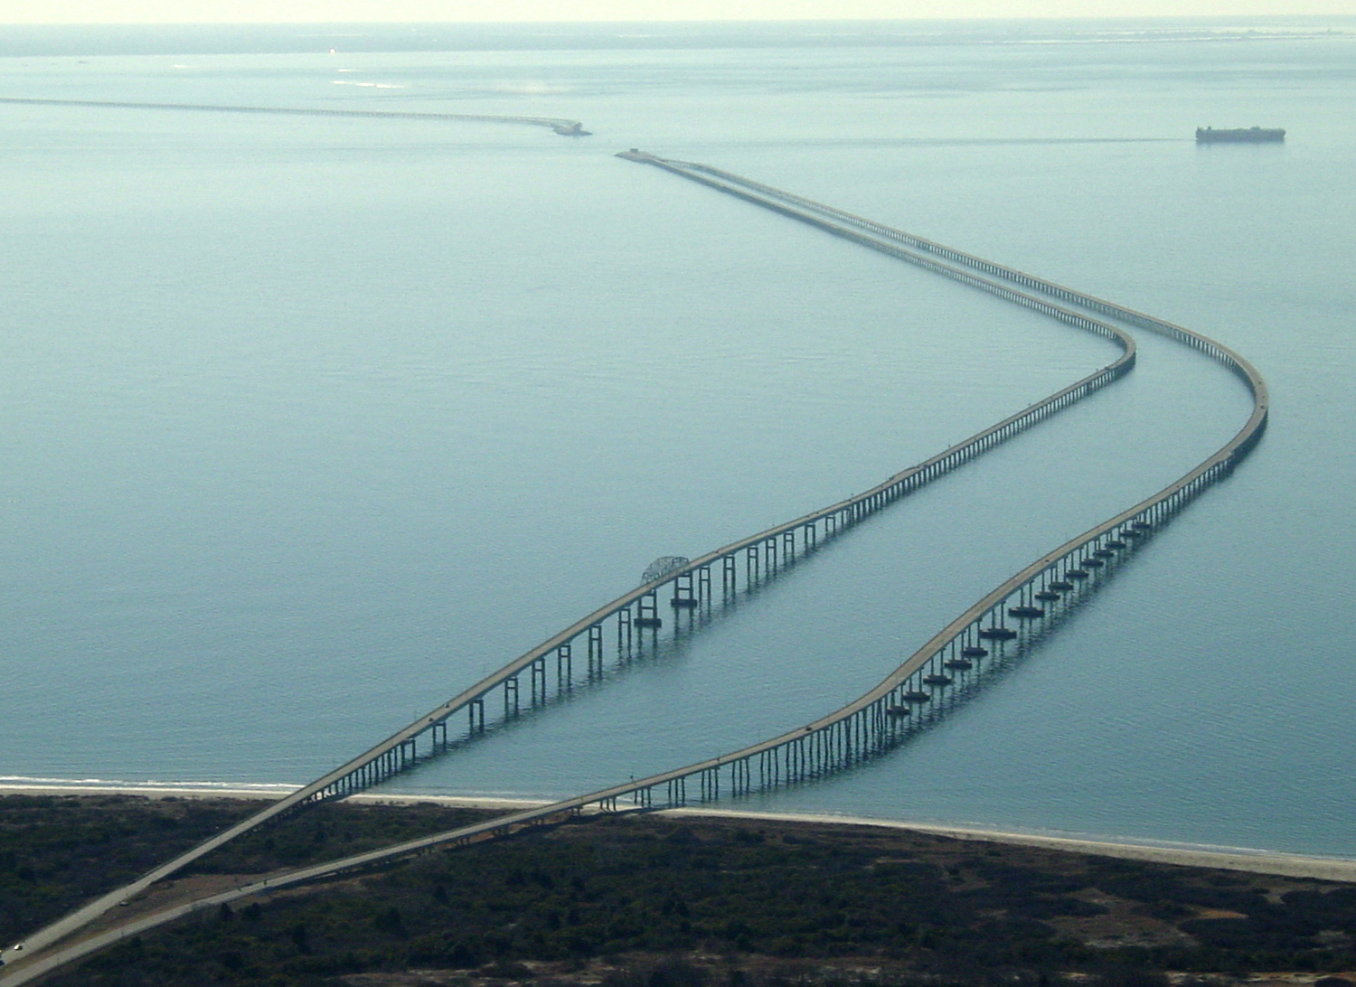

Slide 9
Vital statistics
Lucius J. Kellam, Jr. Bridge-Tunnel
Total Length : 23 miles ( 37.01 km )
Length Shore to Shore : 17.6 miles ( 28.32 km )
Depth of water along Route : 25 to 100 feet ( 7.62 to 30.48 m )

Slide 11
Construction Features
12 miles of low-level trestle
2 one-mile-long tunnels
2 bridges
2 miles of causeway
4 manmade islands
5-1/2 miles of approach roads

Slide 12
Trestles
- Length 12.3 miles
- Northbound width 28 feet
Southbound width 36 feet
Steel : 55,000 tons

Slide 13
Concrete piles for trestles support
Northbound: 2,656
Southbound: 2,149
Concrete : 825,000 tons

Slide 14
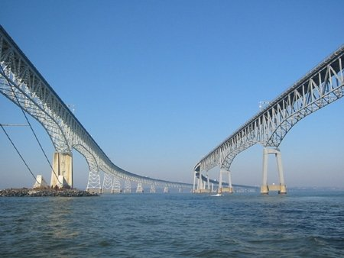

Slide 15
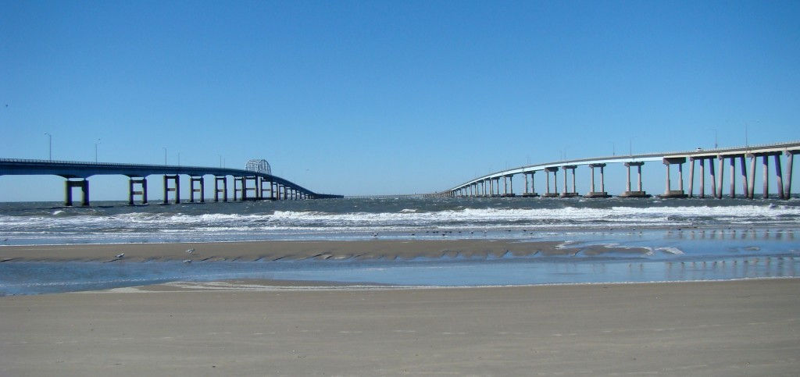

Slide 16
Tunnels
Thimble Shoal Tunnel:
5.552 feet in length,
Chesapeake Channel Tunnel:
5,237 feet in length

Slide 17
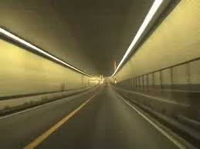

Slide 18
Manmade Islands
4 islands
30 feet above water ( 9.14 m )
Rock Armor : 1,183,295 tons
Sand : 6,000,000 tons

Slide 19
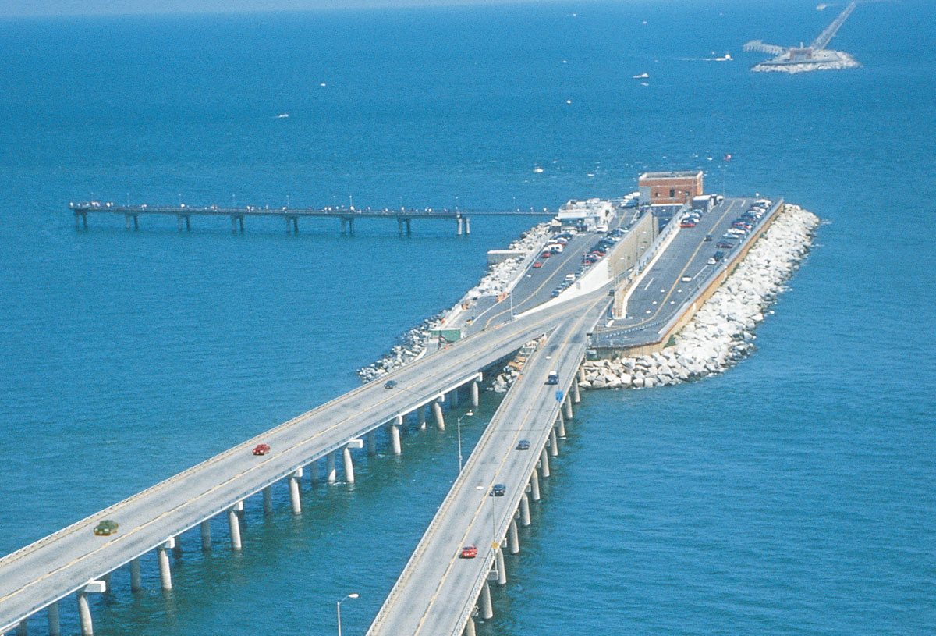

Slide 20
Vital Statistics
Location: Cape Charles and Virginia Beach, Virginia, USA
Completion Date: 1964 ( 1999 )
Cost: $200 million ( $ 250 M )
Length: 37.01 km

Slide 21
Type: Beam bridge, tunnel
Purpose: Roadway
Materials: Steel, concrete
Longest Single Span: 100 feet

Slide 22
Engineer(s): Sverdrup & Parcel

Slide 23
Interesting Facts
one of the seven engineering wonders of the modern world
67 million vehicles a year
Gift shop, restrooms

Slide 24
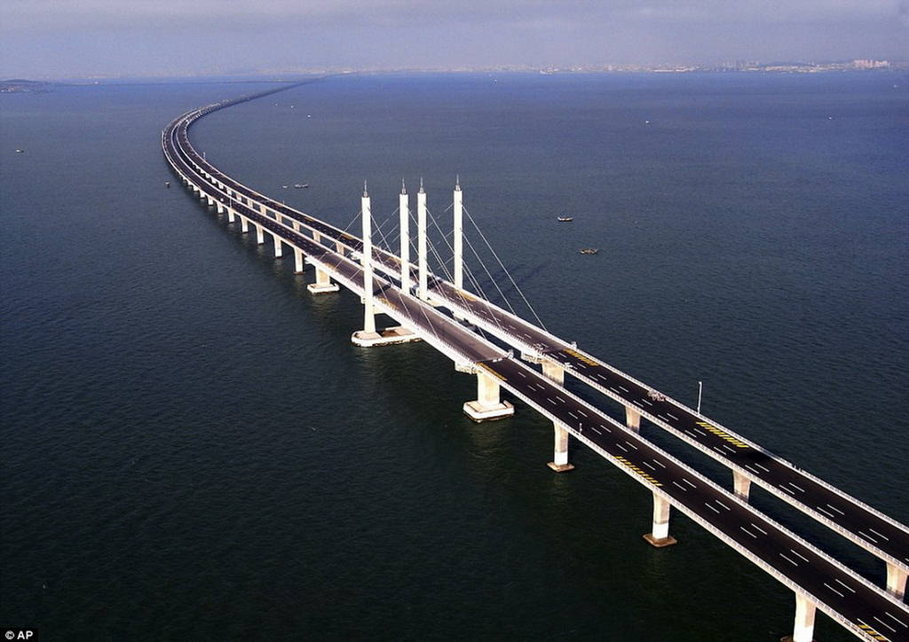
Danyang–Kunshan Grand Bridge

Slide 25
