Slide 1
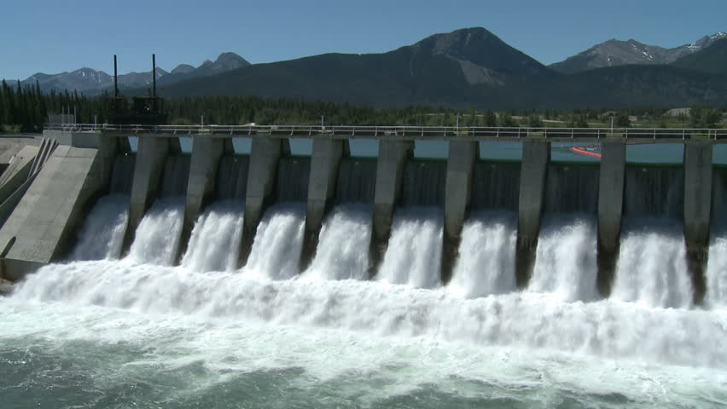
DAMS

Slide 2
Terminology:
irrigation embankment
barrier swift-flowing stream
reservoir valley
to impound water compacted earth
to generate electricity crushed rocks
water-supply system velocity
flood – drought seepage
extensive survey leaking
to dam a river protective features
cofferdam porous material
to divert river sandstone
to excavate a temporary channel silt; silting formation
proximity of transportation facilities to avoid construction fault
masonry dam edifice
embankment dam to trigger eviction
concrete dam inundation
gravity dam to outweigh gains
arch dam navigation
buttress dam

Slide 3
INTRODUCTION
- a dam is a barrier constructed across a stream to impound water and raise its level for different purposes
- reasons for building dams: Irrigation
Hydropower (to generate electricity)
Water-supply
Flood Control
Navigation
Fishing and Recreation
Notes:
Dams are glorious structures no matter the size or the materials used. To think, these structures have the ability to hold back millions of gallons of rushing water. Dams also have the ability to generate energy and electricity that will benefit the population around the dam.
A dam is a barrier built across a river that stops the river's flow and collects the water, especially to make a reservoir (= an artificial lake) that provides water for an area.
In ancient times, dams were built for the single purpose of water supply or irrigation. As civilizations developed, there was a greater need for water supply, irrigation, flood control, navigation, water quality, sediment control and energy. Therefore, dams are constructed for a specific purpose such as water supply, flood control, irrigation, navigation, sedimentation control, and hydropower.

Slide 4
Requirement of dam (world wide %)
Notes:
Demand for water is steadily increasing throughout the world. There is no life on earth without water.
But freshwater resources are limited and unevenly distributed. In the high-consumption countries with rich resources and a highly developed technical infrastructure, the many ways of conserving, recycling and re-using water may more or less suffice to curb further growth in supply. In many other regions, however, water availability is critical to any further development above the present unsatisfactorily low level. In these regions man cannot forego the contribution to be made by dams and reservoirs to the harnessing of water resources.
Most of the dams are single-purpose dams, but there is now a growing number of multipurpose dams. Among the single purpose dams, 48 % are for irrigation, 17% for hydropower (production of electricity), 13% for water supply , 10% for flood control, 5% for recreation and less than 1% for navigation and fish farming.

Slide 5
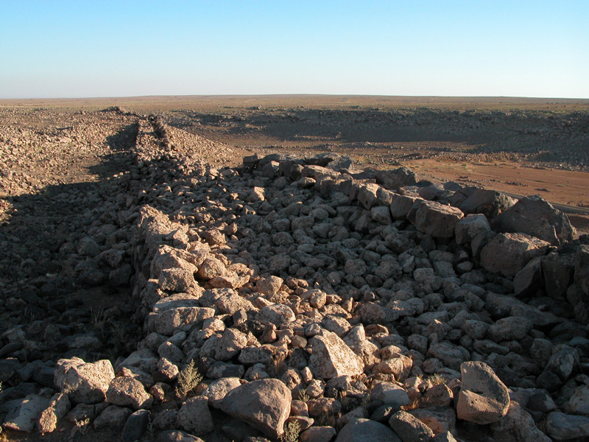
ANCIENT DAMS
The earliest known dam is the Jawa Dam in Jordan, 100 kilometres northeast of the capital Amman.
The structure is dated to 3000 BC
Notes:
The first known dam to be built is the Jawa Dam, which is actually the largest in a series of dams that are all part of one reservoir system. Located in modern-day Jordan, the Jawa Dam was originally constructed around 3,000 BCE in what was then Mesopotamia. Surprisingly, the Jawa Dam was actually an architectural feat of the times. While most ancient dams were simple gravity dams constructed of gravel and masonry, the Jawa Dam was reinforced with rock fill behind the upstream wall in order to protect the wall from water pressure breach. This safety feature was incredibly innovative for this time period.

Slide 6
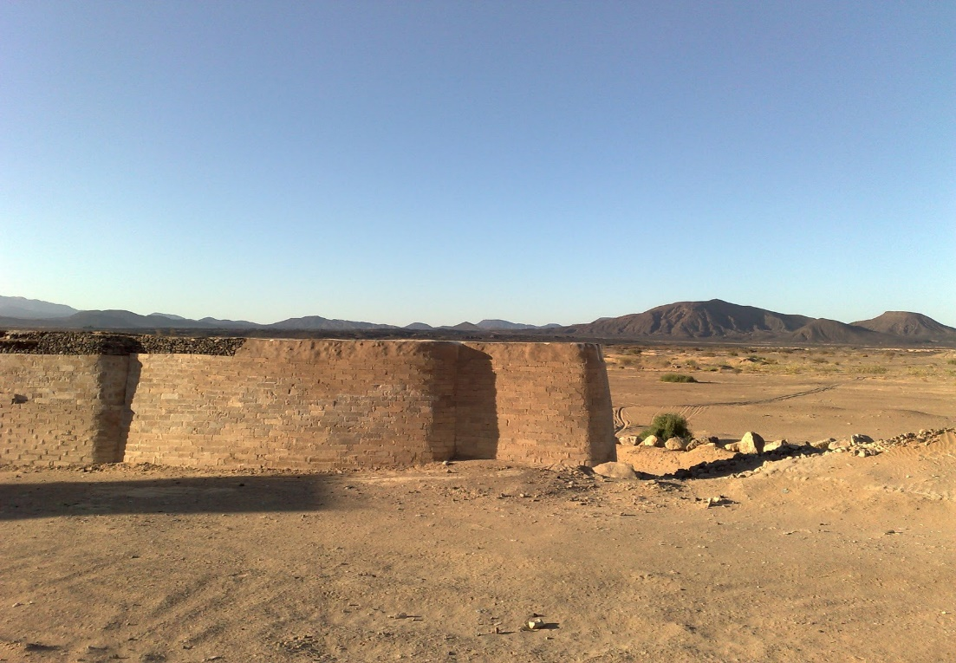
ANCIENT DAMS
Sadd-el-Kafara Dam, Egypt
2800-2600 BC
Great Dam of Marib, Yemen
1750-1700 BC
Notes:
Subsequent ancient dams were built by several cultures with varying rates of success. Approximately 400 years after the construction of the highly successful Jawa Dam, Egyptians built the Sadd el-Kafara, or Dam of the Pagans, most likely to supply water to the local quarries outside of Cairo rather than for irrigation, since the flooding Nile would have supplied plenty of water to the farmers. Unfortunately, after ten years of construction, as it was nearing completion, it failed. Due to poor design and lack of a spillway, the dam was washed away during a heavy rainfall and was never repaired or completed. Discouraged by the failure of this massive project, ancient Egyptians were dissuaded from constructing other dams until many years later.

Slide 7
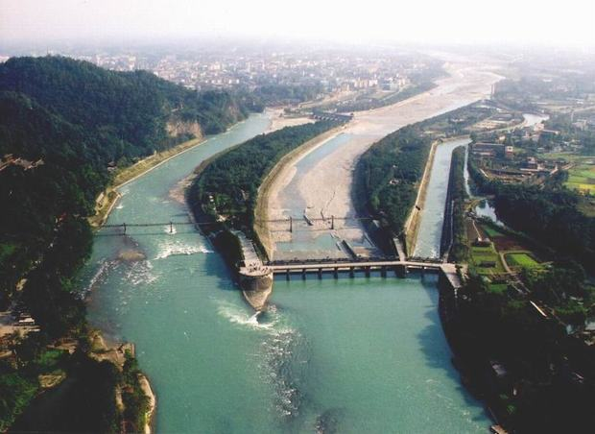
ANCIENT DAMS
Kallanai Dam, India
2nd century AD
One of the oldest hydraulic structures in the world still in use.
Dujiangyan irrigation system, China
256 BC
The oldest surviving irrigation system

Slide 8
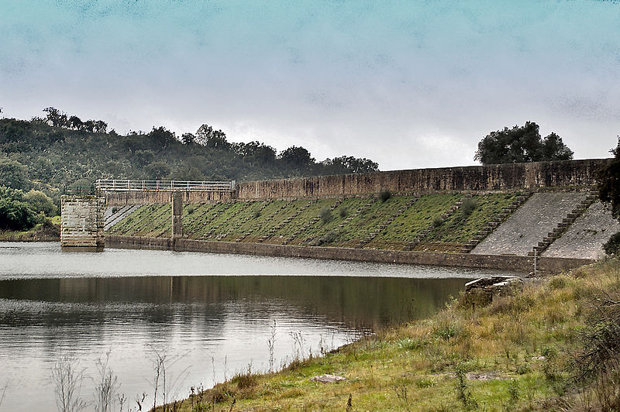
ROMAN ENGINEERING
Remains of the Band-e Kaisar dam, Iran, built by the Romans in the 3rd century AD
The Roman dam at Cornalvo, Spain has been in use for almost two millennia.
Notes:
The Romans, highly regarded for their advances in hydraulic engineering, were prolific in dam construction during the height of the empire. In addition to the vast network of aqueducts, the Romans built gravity dams. The Romans also constructed the world’s first arch dam and they were also responsible for constructing the world’s first buttress dams.
Major advances in concrete dam design were made from 1853 to 1910 by British and French engineers.

Slide 9
TYPES OF DAMS
BY STRUCTURE
Arch dam
Gravity dam
Buttress dam *
Embankment dam*
Arch-gravity dam
*raščlanjena brana
*nasuta brana
Notes:
There are many types of dams available. Mostly dams can be classified into different types based on the design and structure of the dam.

Slide 10
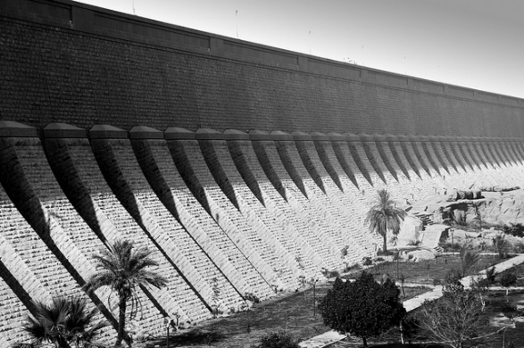
MASSIVE DAMS
The era of large dams - initiated with the construction of the Aswan Dam in Egypt in 1902 by the British.
When initially constructed between 1899 and 1902, it was the largest masonry dam in the world.
Notes:
A dam is called as small dam if its gross storage (total quantity of water stored) capacity is in between 0.5 to 10 MCM (million cubic meters). Hydraulic head of small dam is generally about 7.5 to 12 meters.
A dam is said to be large dam if its gross storage capacity is above 60 MCM. Hydraulic head of a large dam is greater than 30 meters.

Slide 11
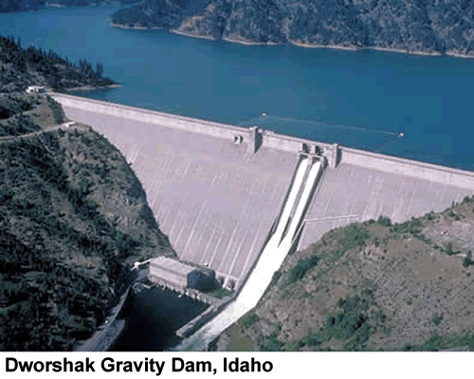
GRAVITY DAM
It is called a gravity dam because gravity holds the dam down to the ground and stops the water from toppling it over.

Slide 12
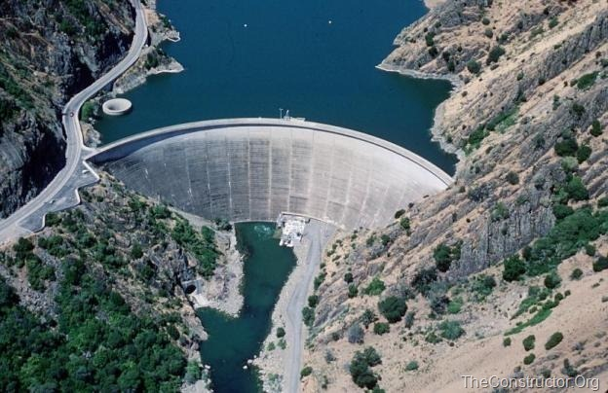
Arch Dam – Idukki Dam, India

Slide 13
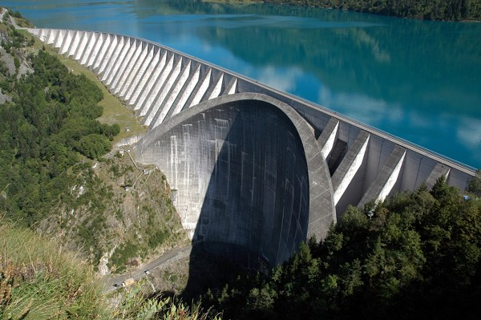
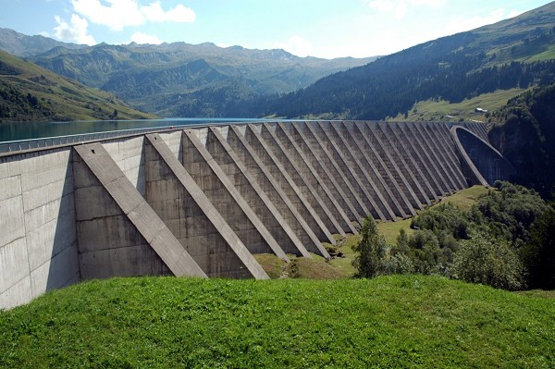
BUTTRESS DAM
Roselend Dam, France

Slide 14
EMBANKMENT DAMS
Notes:
Embankment dam is made of soil or rocks. This type of dams are come under non rigid type dams.

Slide 15
EMBANKMENT DAM
Tataragi Dam in Japan

Slide 16
FACTORS AFFECTING SELECTION OF TYPE OF DAM
Topography
Geology and Foundation Conditions
Availability of materials
Earthquake zone
Height of the Dam
Other factors such as cost of construction and maintenance, availability of construction materials, proximity of transportation facilitiesetc.

Slide 17
ADVANTAGES OF DAMS
40 % Of world food production comes from Irrigated
forming out of which 16% is contributed due to
dams.
30-40% of 268 million hectares of irrigated land is
watered from dams
19% of world energy comes from hydro-electric
power ( which includes 150 countries)
90% of 24 countries
50% in 63 countries

Slide 18
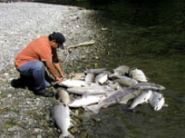
SOME NEGATIVE IMPACTS OF DAMS

Slide 20
CONCLUSION
Dams have made an important and significant contribution to human development, and the benefits derived from them have been considerable. Dam building has been one of the most disputed topics affecting the environment today. The push and pull between the pros and cons have created conflicts among different groups. While dams destroy the nature and people surrounding the area in which they are built, they do provide people with water and products from water. The solutions are minimal, but the damages could be decreased depending on the placement of the dam.

