Slide 1
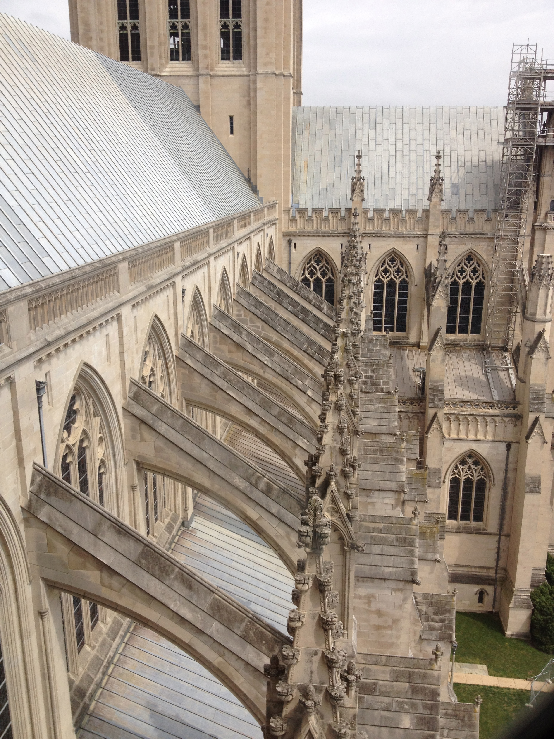
GOTHIC ARCHITECTURE
12th – 16th century, Northern France
pointed arches, ribbed vaulting, flying buttresses
„the French style”
„gothic” – barbaric – the Goths
410 – Goths vandalized Rome

Slide 2
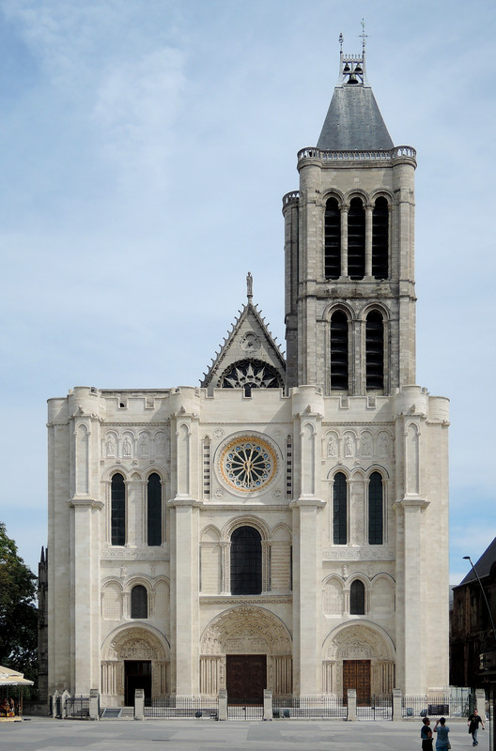
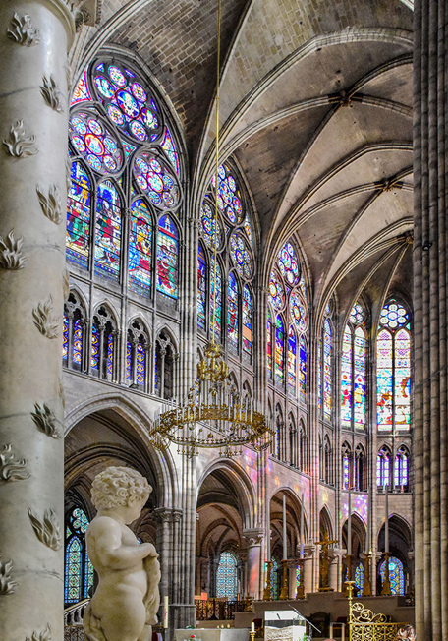
THE FIRST GOTHIC CATHEDRAL
Abbot Suger
Basilica of Saint-Denis
1140 A.D. – the first gothic cathedral
dramatic departure from the romanesque style
„modern” – „gothic”

Slide 3
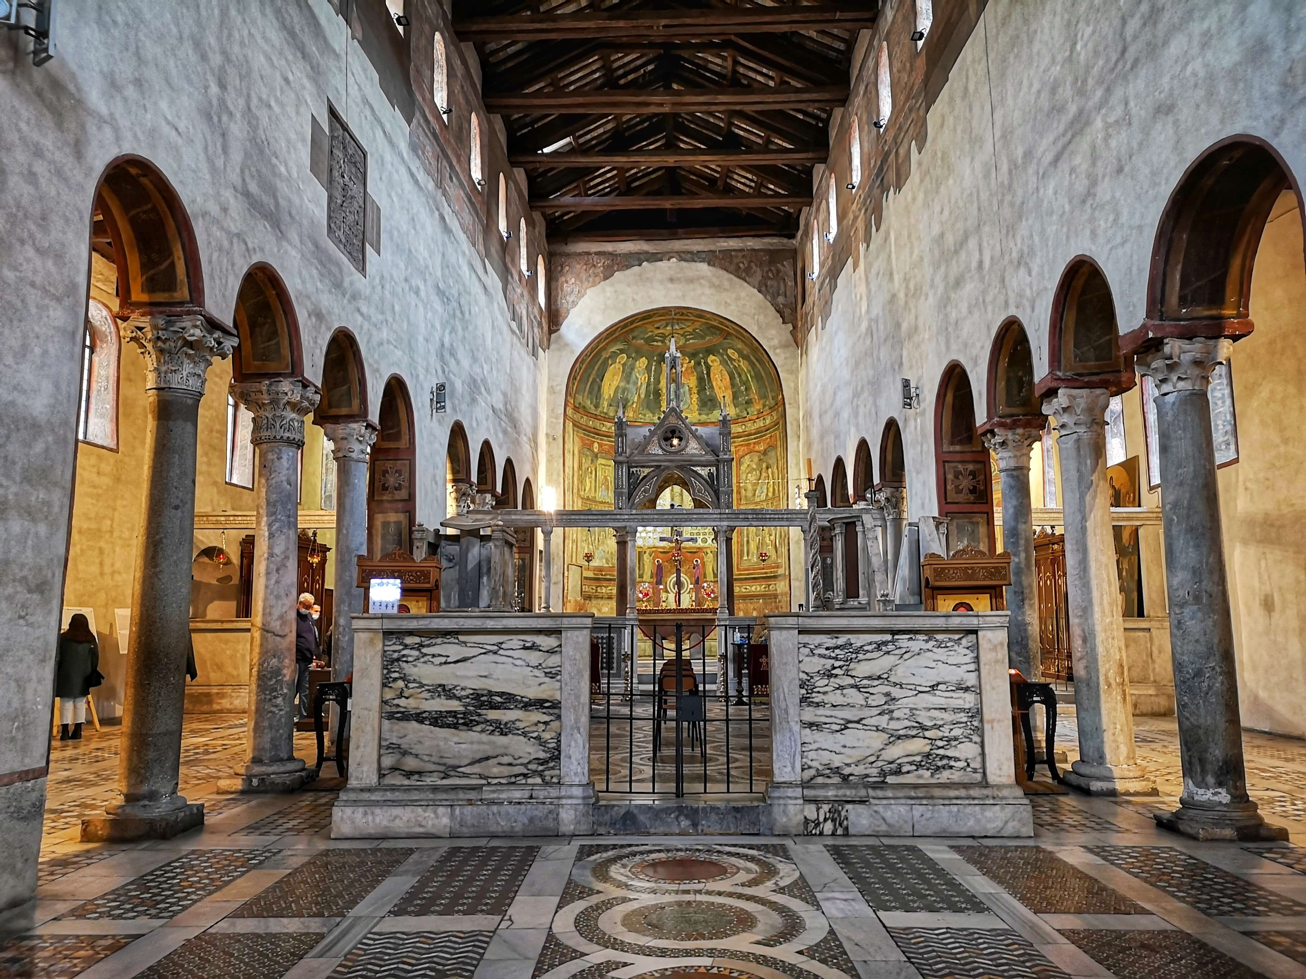
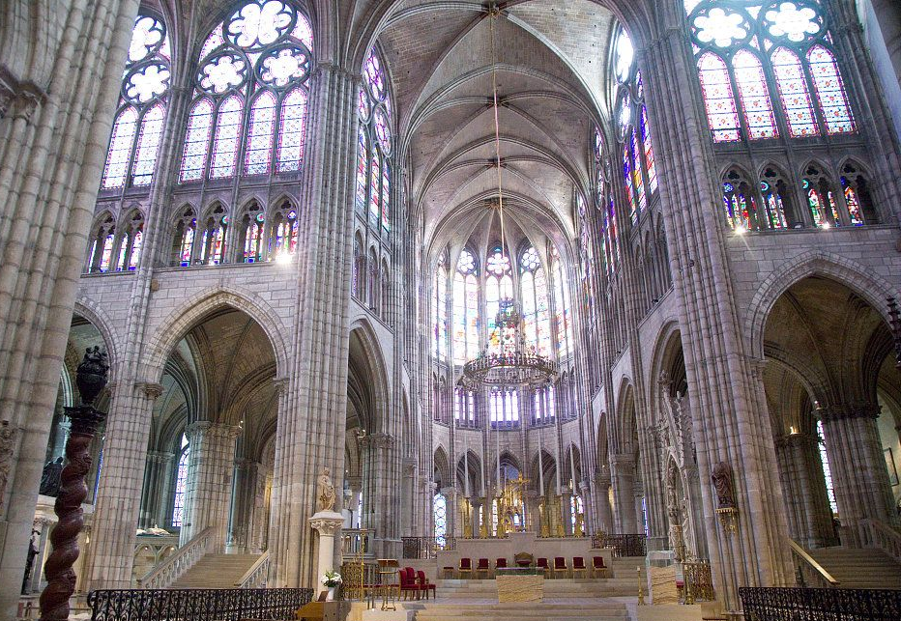
ROMANESQUE VS. GOTHIC
HEAVY | LIGHT
Santa Maria, Cosmedin Basillica of St. Denis, Paris

Slide 4
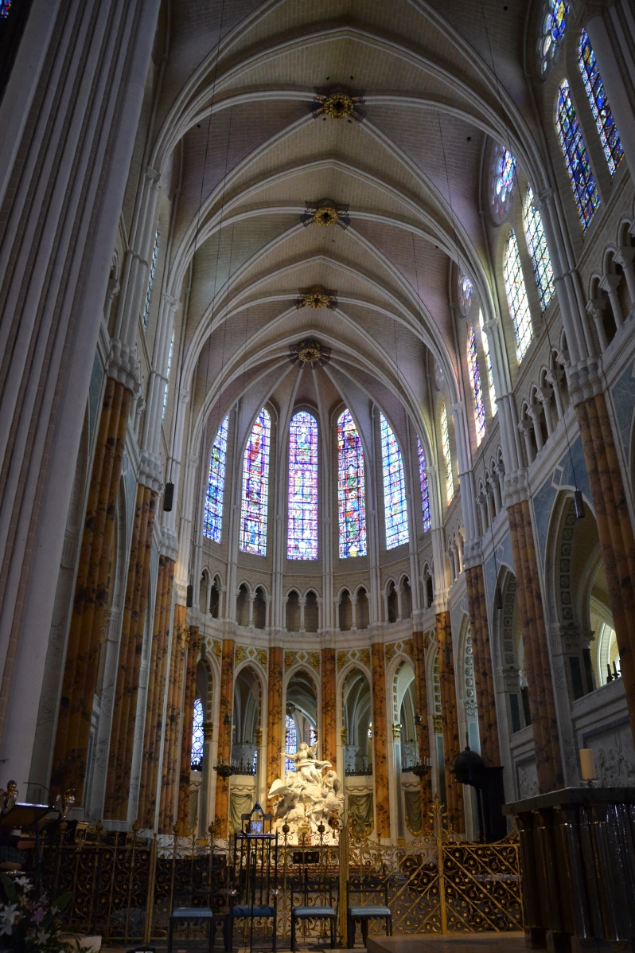
USE OF SHAPE
ROUNDED | POINTED
Palatine Chapel, Aachen Chartres Cathedral

Slide 5
a stress line: The direction in which the arch distributes the pressure above it.

Slide 6
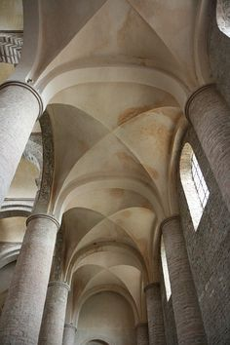
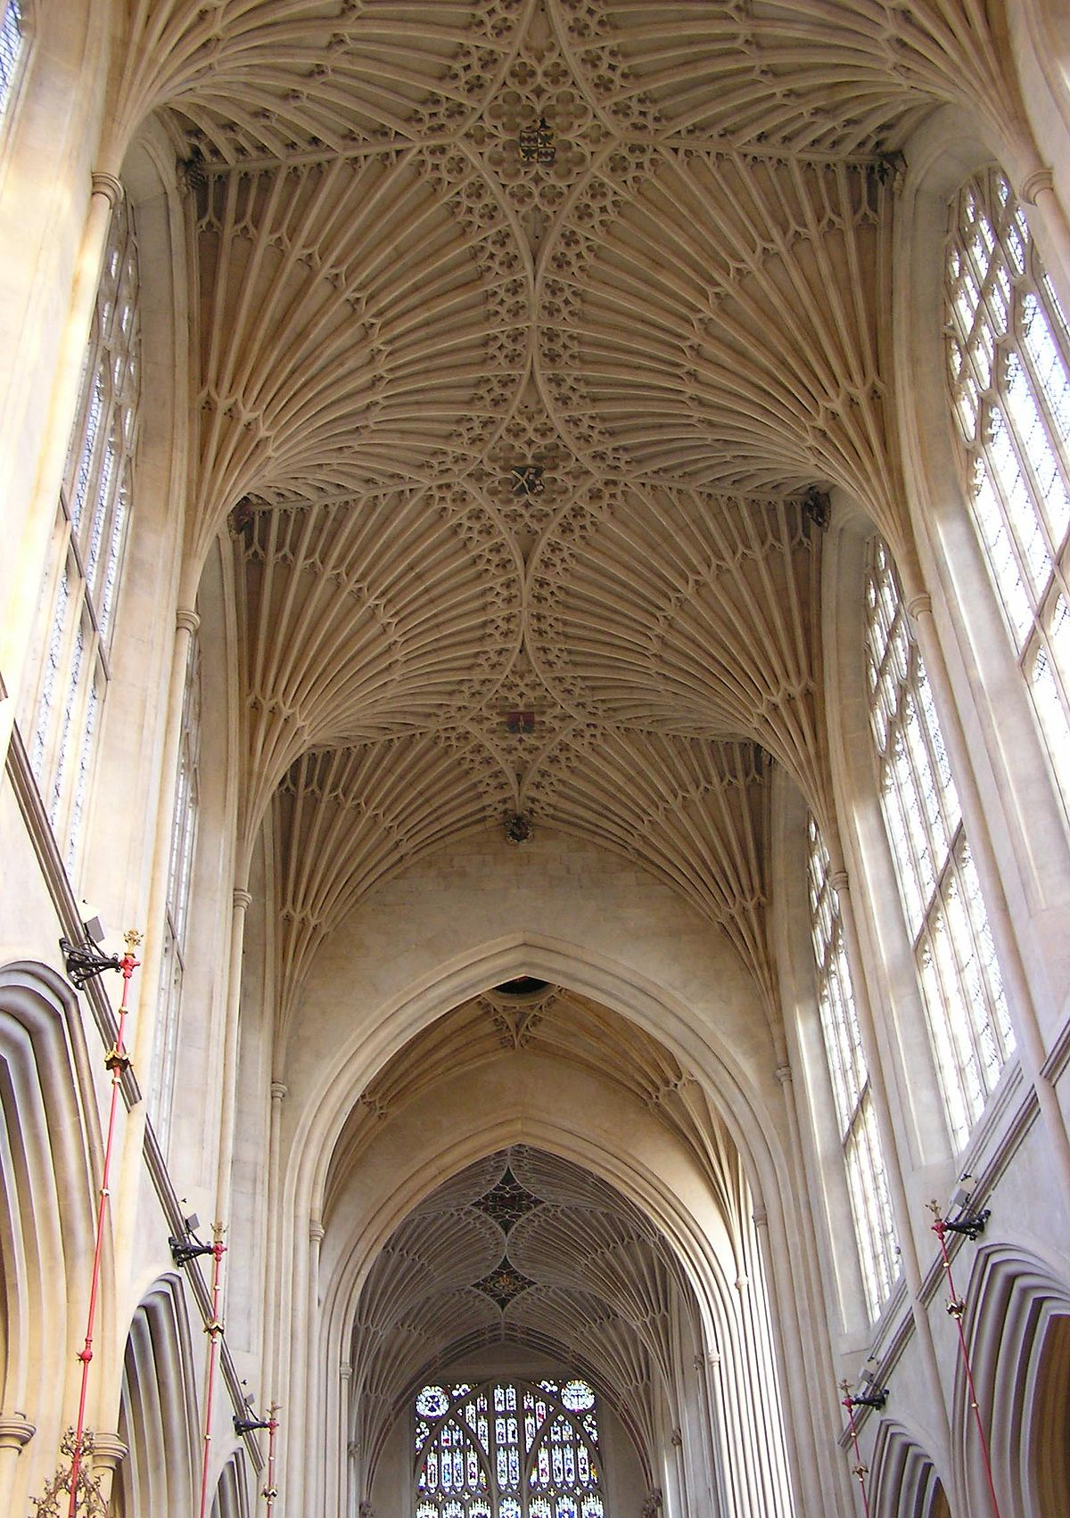
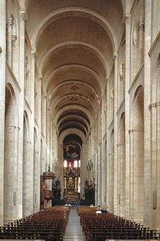
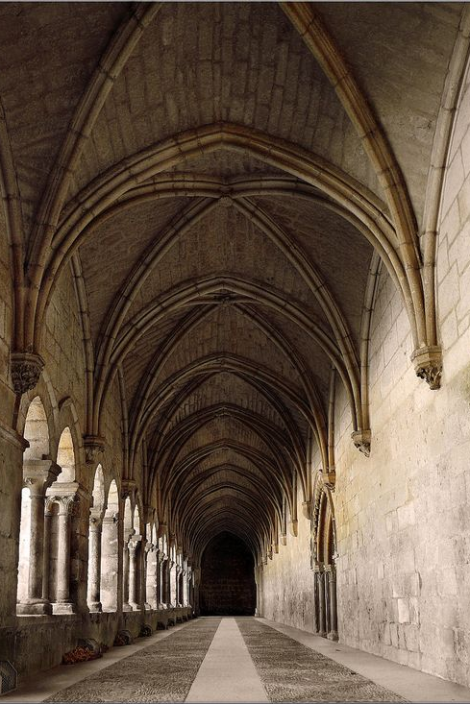
VAULT TYPE
BARREL AND GROIN VAULTS | RIB AND FAN VAULTS

Slide 7
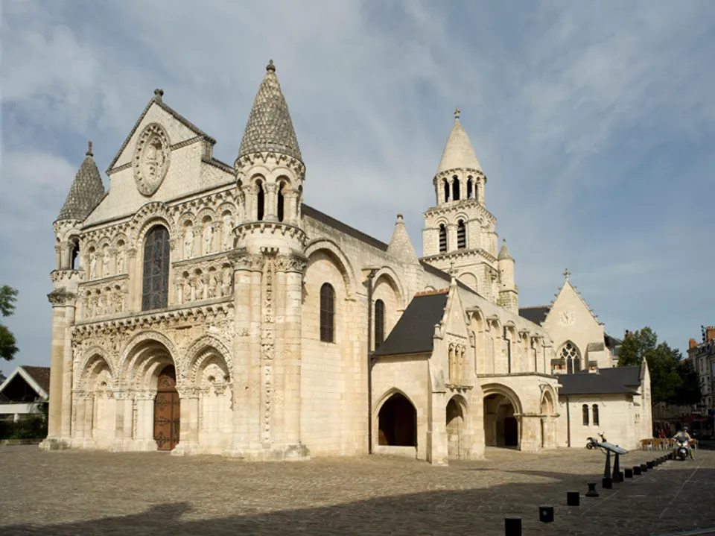
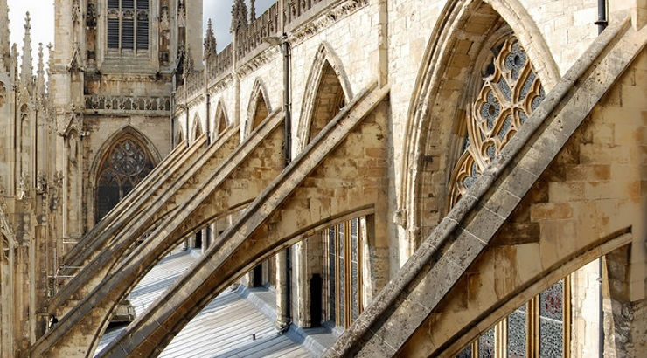
MAIN VAULT SUPPORT
THICK WALLS | FLYING BUTTRESSES

Slide 8
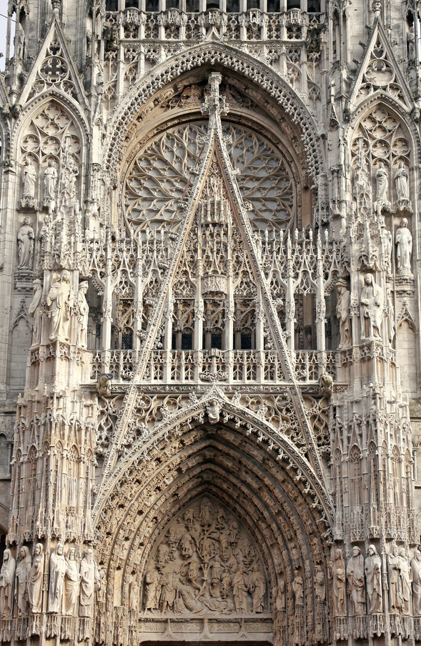
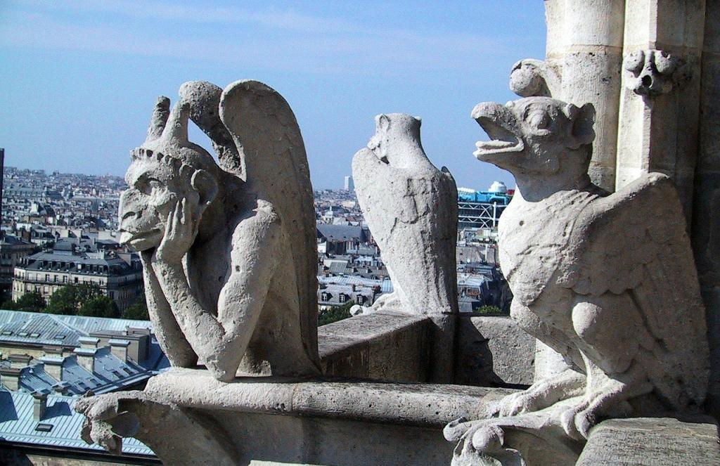
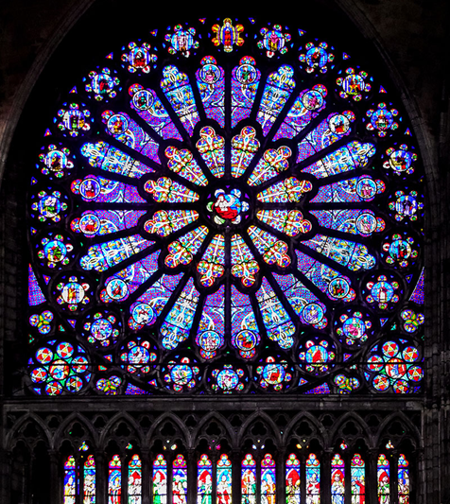
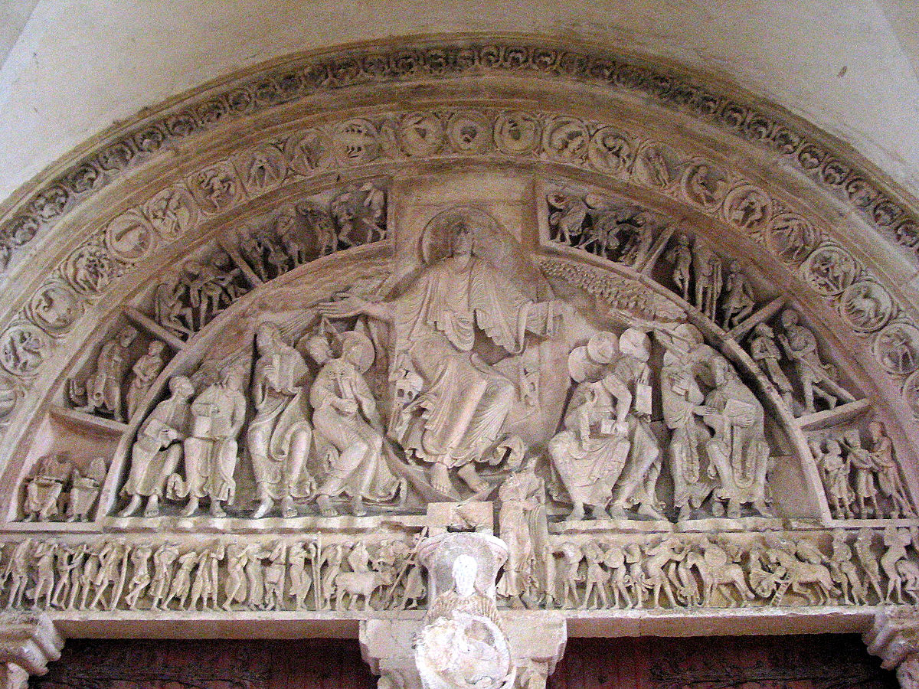
ORNAMENTS
SIMPLE | ORNATE

