Slide 1
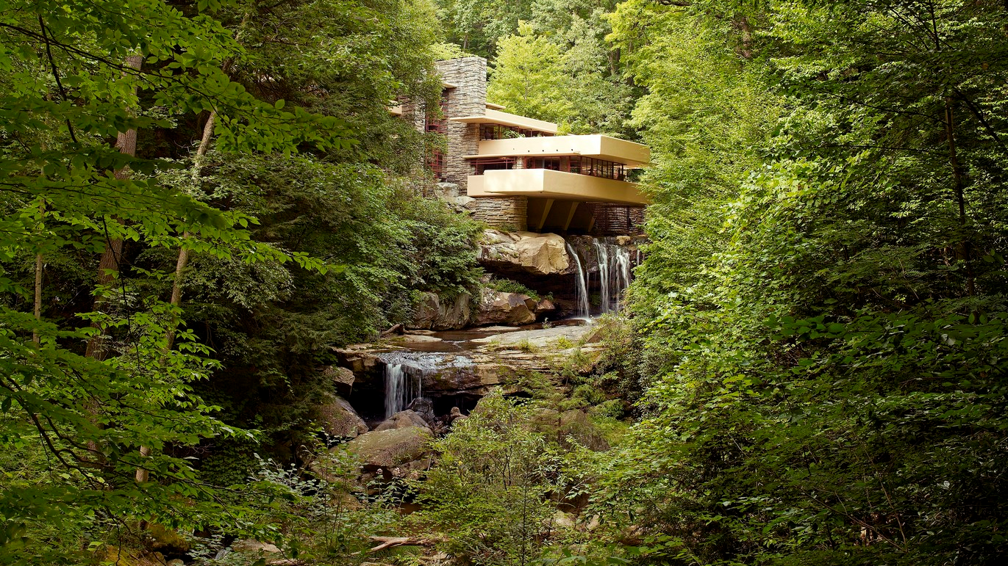
ORGANIC architecture

Slide 2
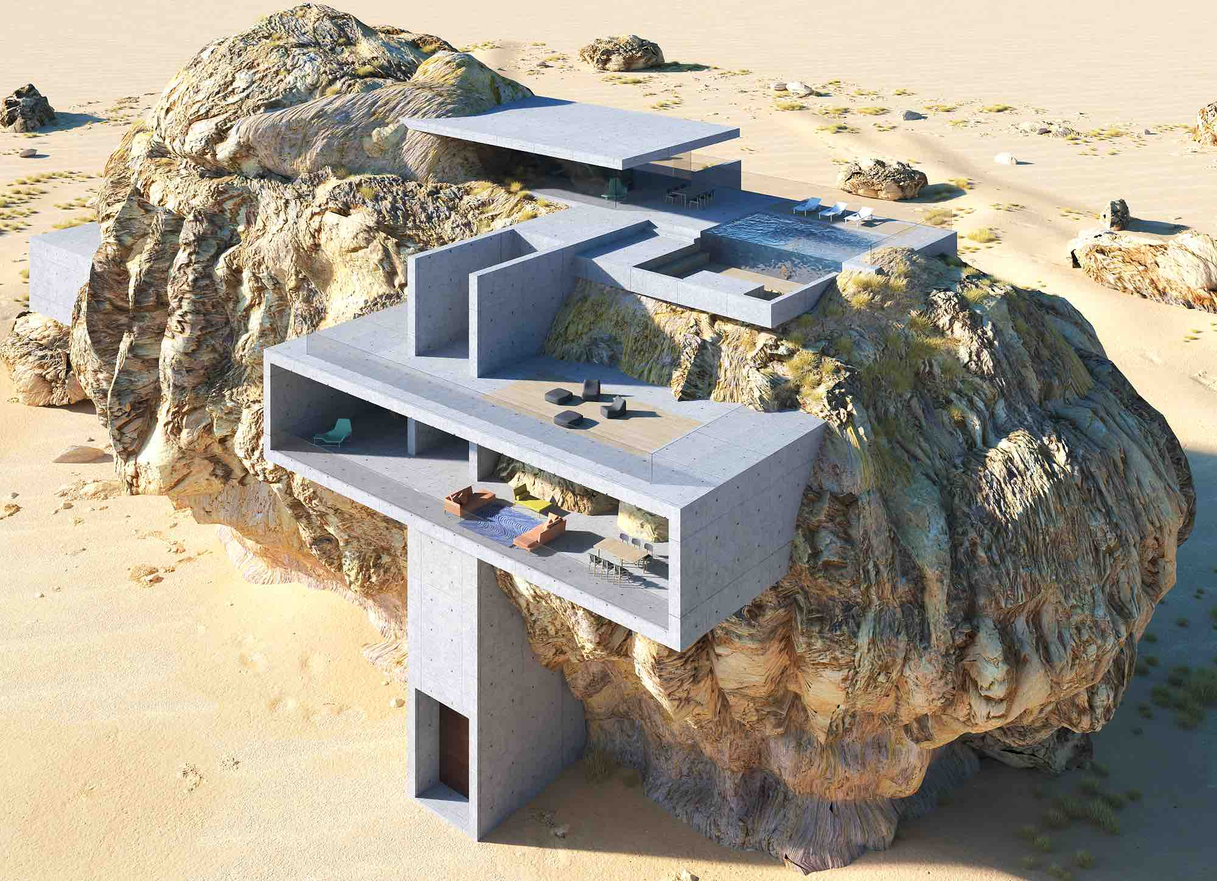
What is organic architecture?
Concept
Wright’s principles
History
Examples
House inside a rock designed by Amey Kandalgaonkar

Slide 3
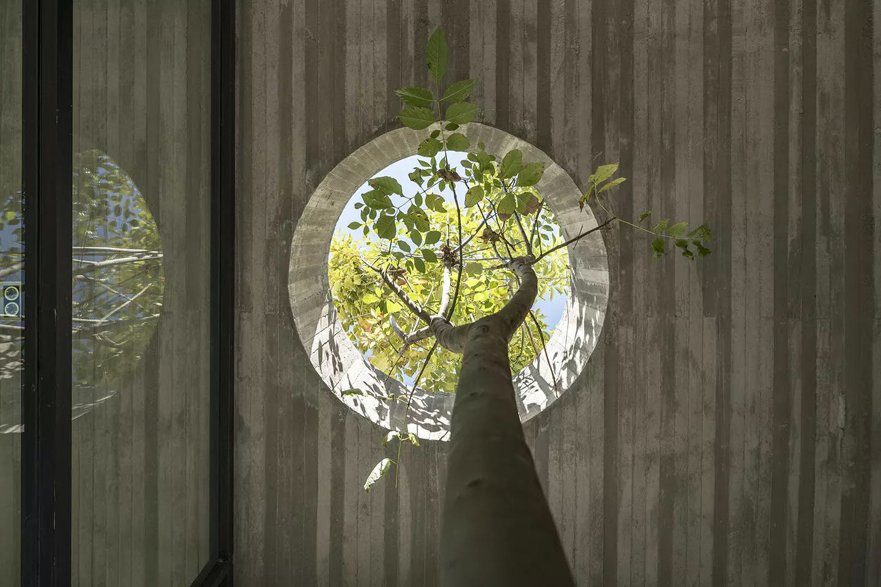
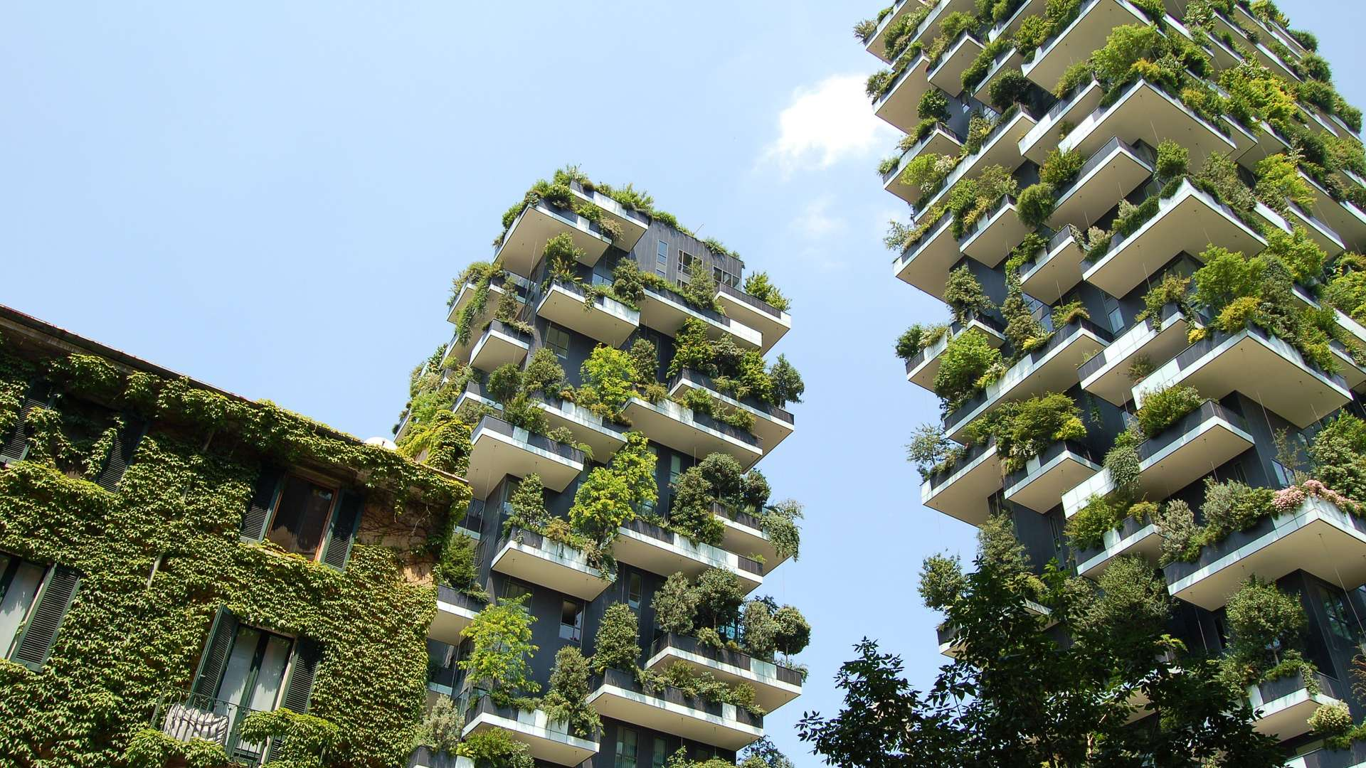
What is organic architecture?
Inspired by nature
Coexistance

Slide 4
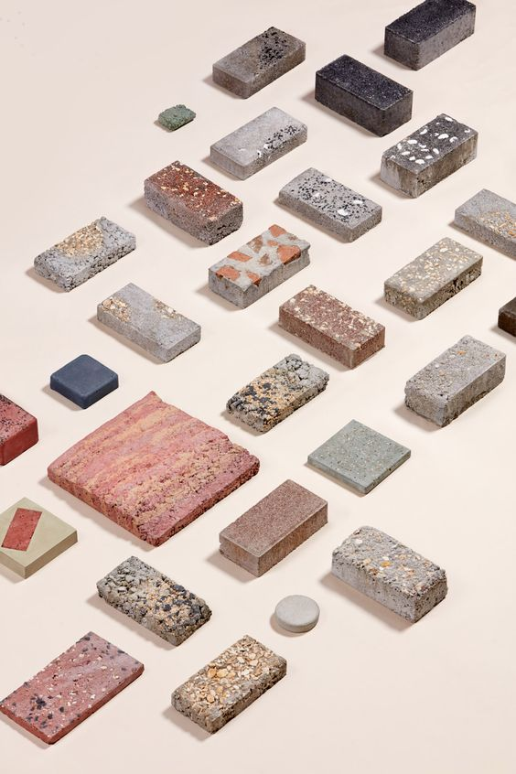
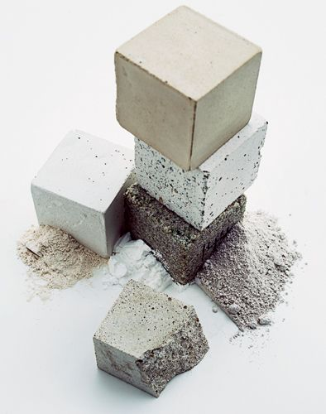
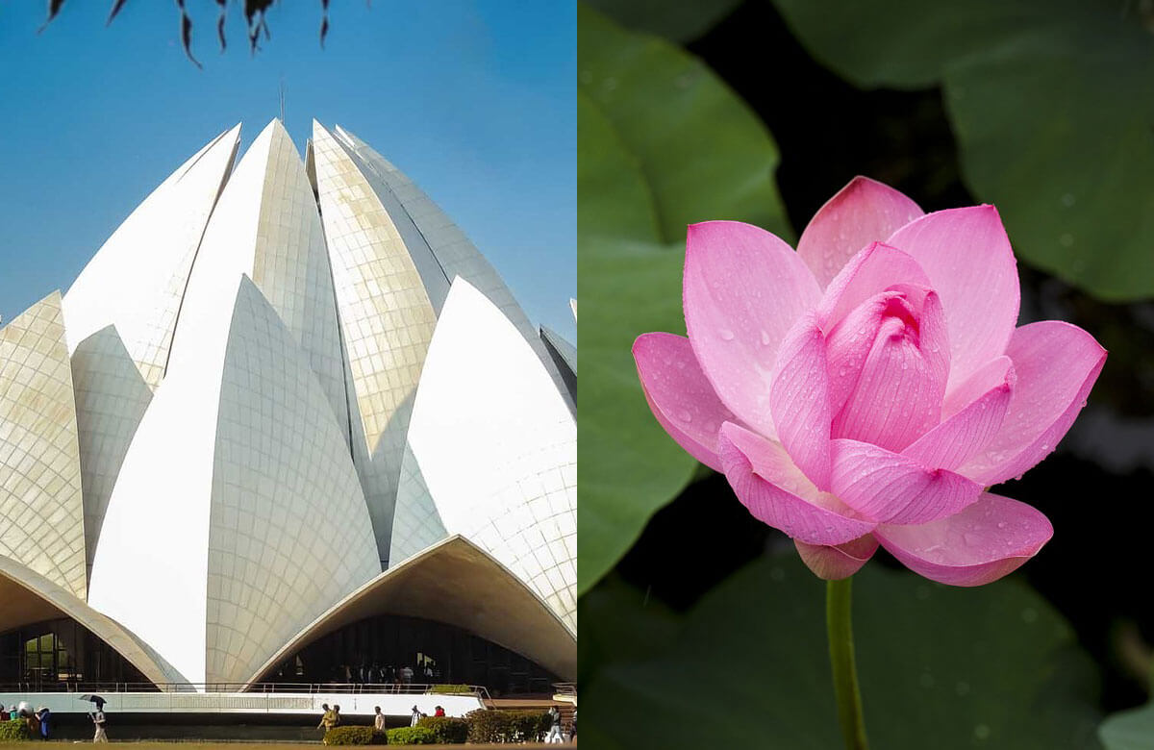
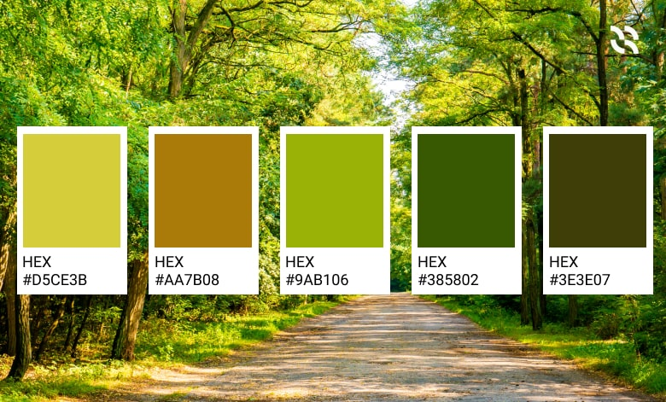
Concept
Unified ecosystem
Local materials
Forms inspired by nature
Colors
Fariborz Sahba, Lotus temple
House inside a rock designed by Amey Kandalgaonkar

Slide 5
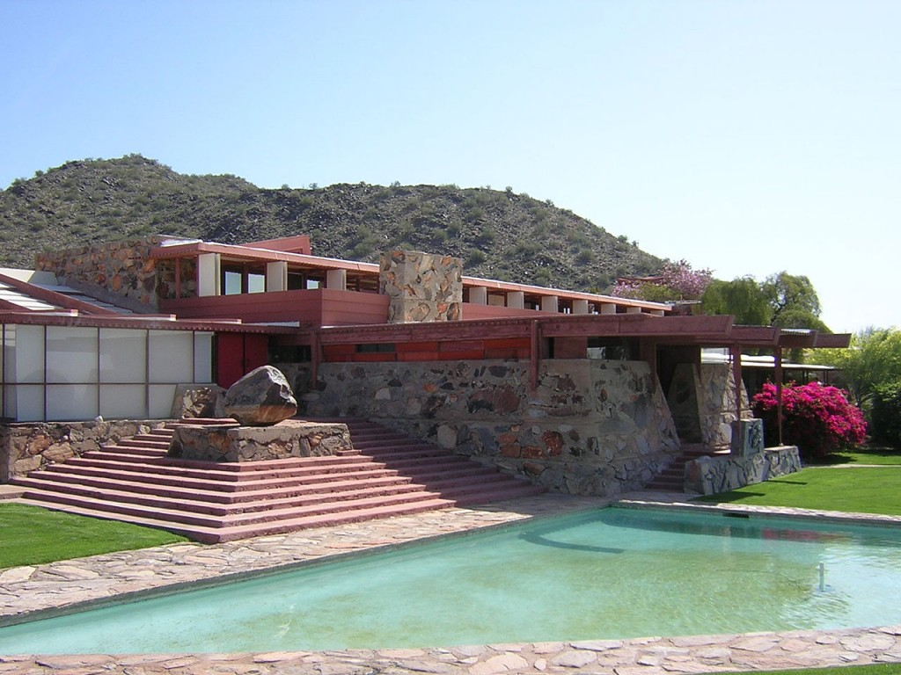
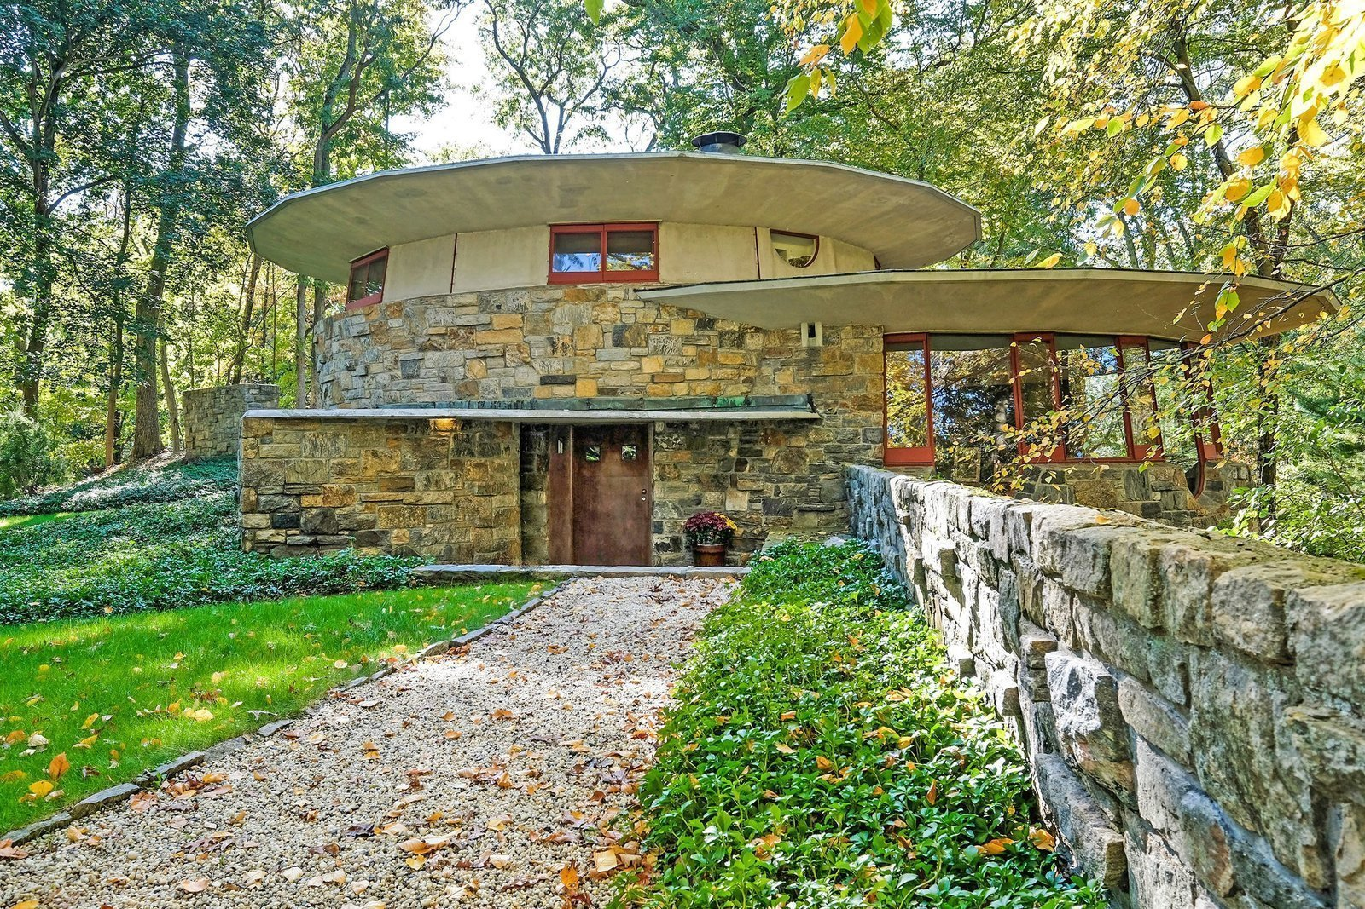
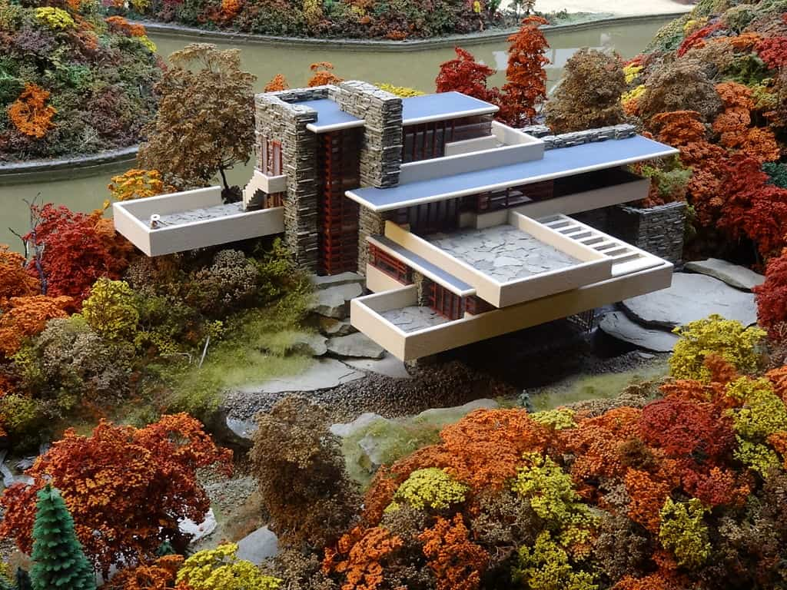
Wright’s principles
Space
Shelter
Nature
Peacefulness
Language
Simplicity
Mechanical components and furniture

Slide 6
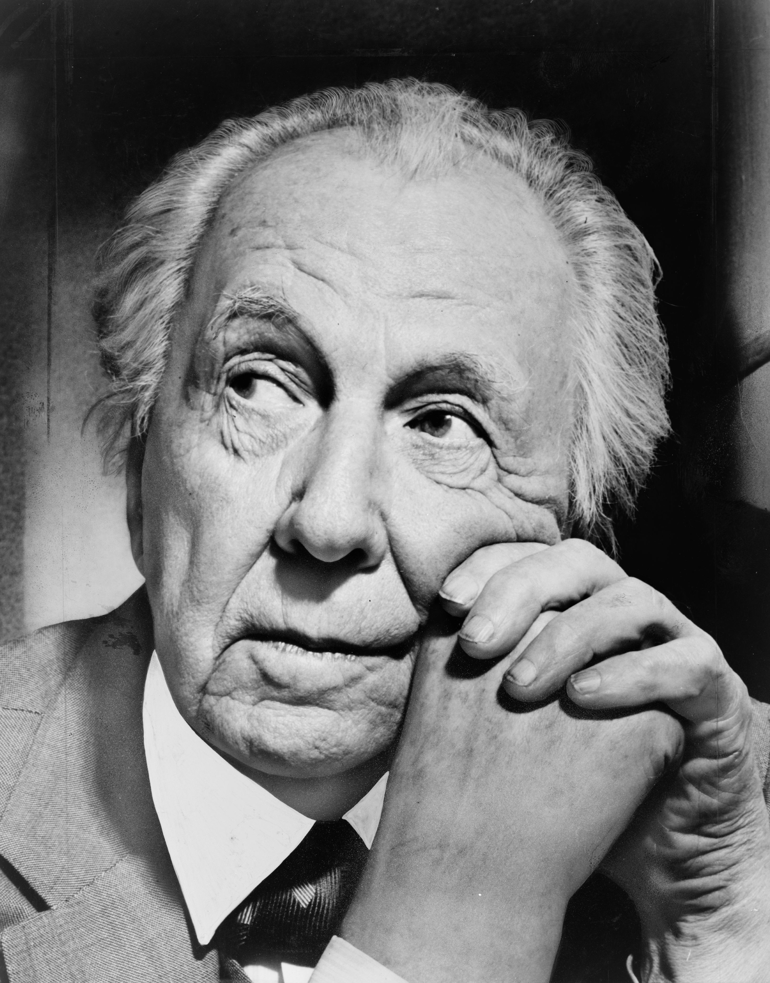
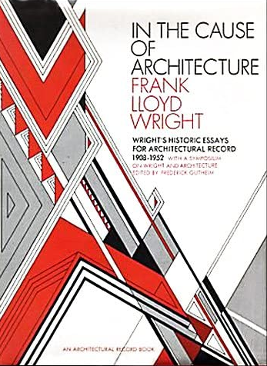
History
1908.
In the Cause of architecture (1908.)
Language of an Organic Architecture (1953.)

Slide 7
F. L. WRIGHT,
fallingwater

Slide 8
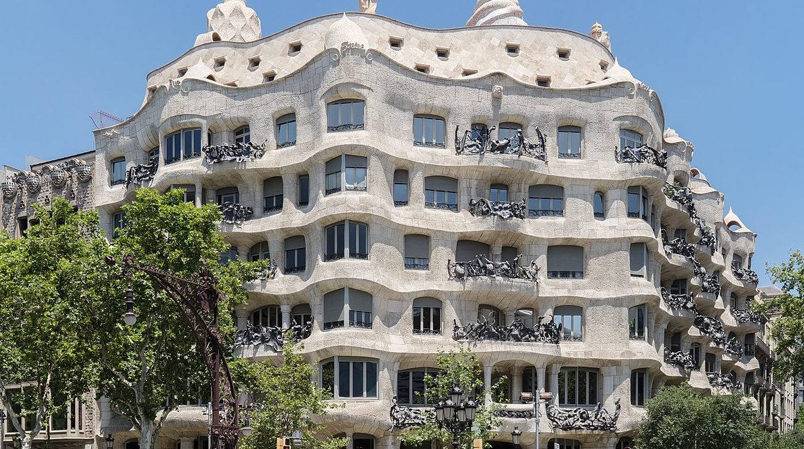
Antoni gaudi,
CASA MILà

Slide 9
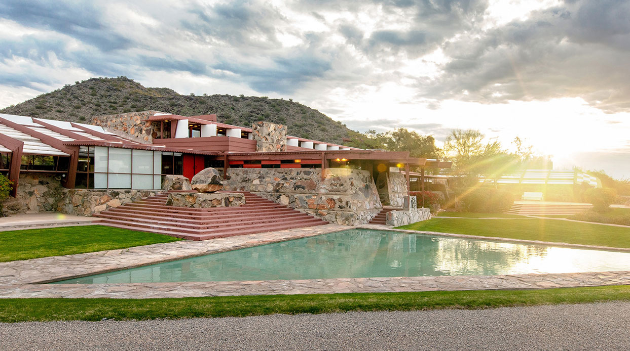
f. l. wright,
Taliesin west

Slide 10
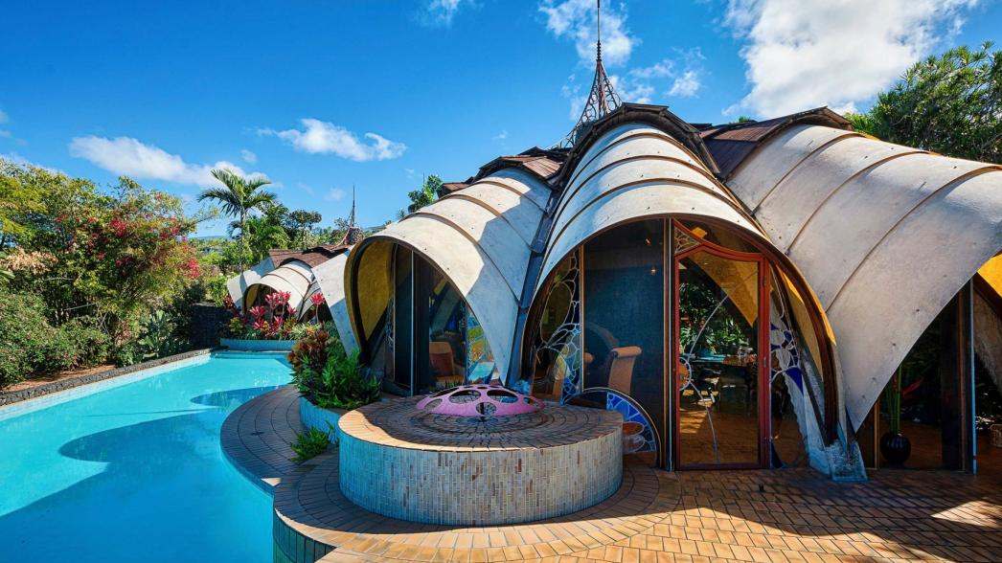
Kendrick Bangs Kellog,
The onion house

Slide 11
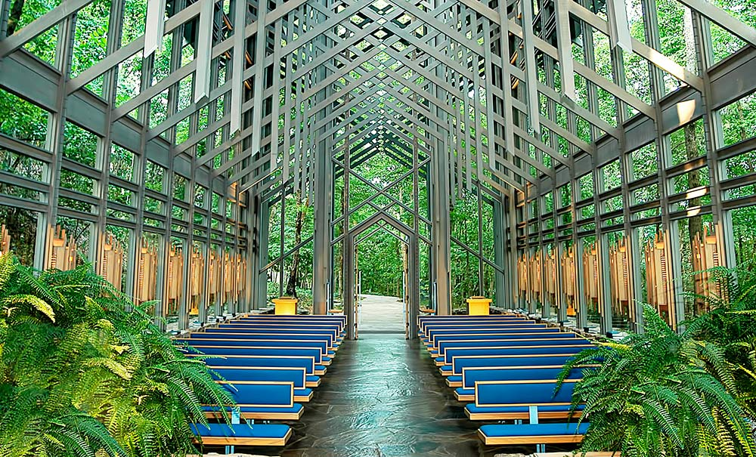
EUINE FAY JONES, THORNCROWN CHAPEL
https://www.youtube.com/watch?v=uG_t6iGNYH0

Slide 12
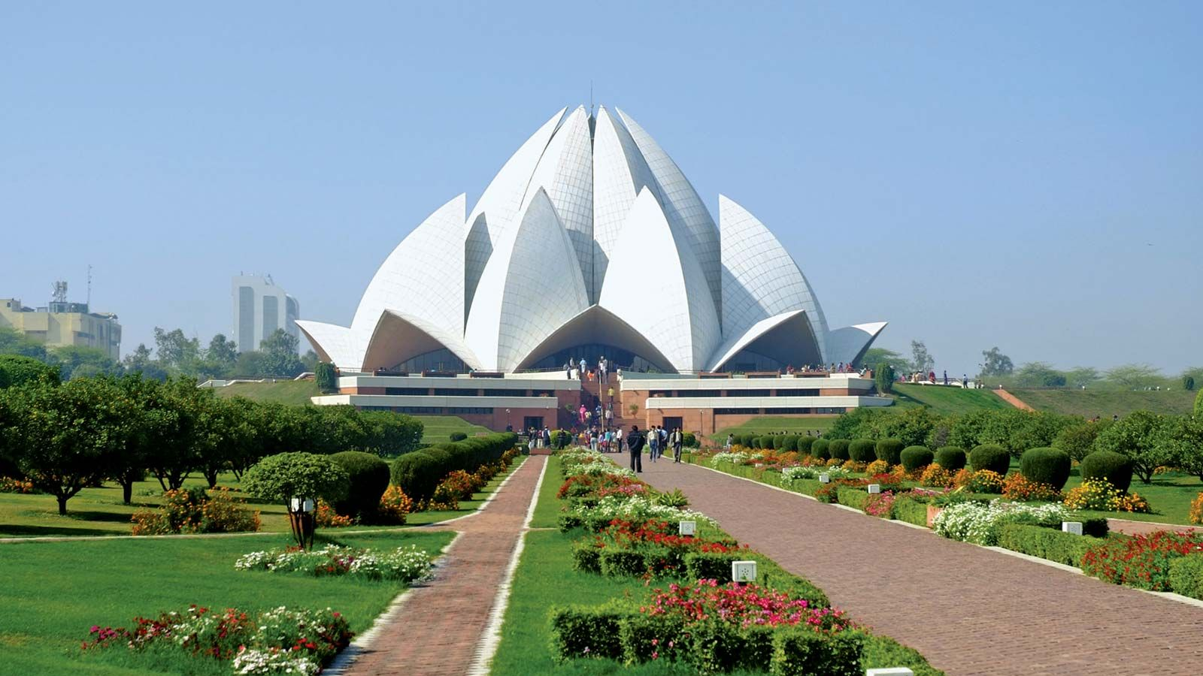
Fariborz sahba,
Lotus temple

