Slide 1
Some Top New Green Building Materials

Slide 2
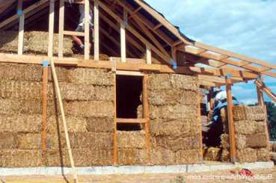
STRAW/STRAW BALE
typical for Africa
affordable and sustainable,popularity is Increasing rapidly.
energy-efficient material with good thermal insulating property.
Since air cannot pass through the straw bale, it is a soundproof material.
available everywhere in the world.

Slide 3
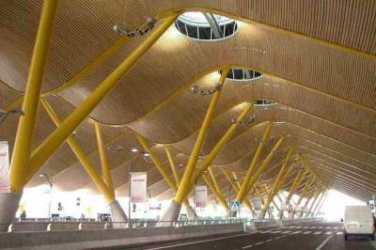
BAMBOO
bamboo is one of the biggest natural building materials in the world.
It is a fast-growing plant and can be great sustainable material.
These are very durable and strong materials
We can easily install them
Bamboo absorbs more amount of oxygen than other trees, as the growth rate is faster.
This is an affordable material and can be used widely.
Bamboo also used in earthquake-prone areas due to their lightweight nature.

Slide 4
CORK
natural, renewable, recyclable raw material that helps in the reduction of harmful greenhouse gases.
due to the thermal insulation property of the cork, it is gaining popularity.
waterproof, lightweight, and resistant to moisture.
using cork we can increase the quality of air, and comfort.
in recent years innovation and development of composite cork.

Slide 5
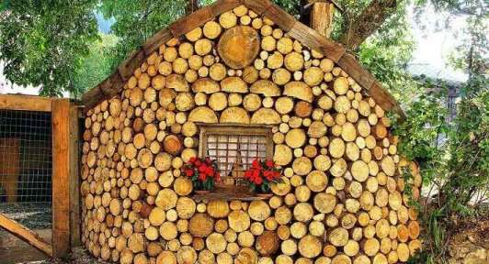
CORDWOOD
use of round and short wood pieces, so these wood pieces don’t have much other value.
have both Insulation and thermal mass.
constructed with less initial cost than other wooden framed houses.
the properties of cordwood are mostly similar to natural wood
available everywhere.

Slide 6
RAMMED EARTH
constructed by compacting the moisture subsoil earth material between the temporary formwork panels. When dried they gain stability and strength.
traditional way of construction,
natural and readily available material.
recyclable material as the soil is again used after demolition.
low energy material and has greater thermal mass.
fireproof material

Slide 7
ASH-CRETE
ash-crete is nothing but using fly ash instead of cement in the production of concrete.
waste product released after the burning of charcoal and it is a non-biodegradable material.
requires less amount of water than cement in the production process.
cheaper and eco-friendly
with the usage of ash-crete, we can increase the strength and durability of concrete while decreasing its permeability.

Slide 8
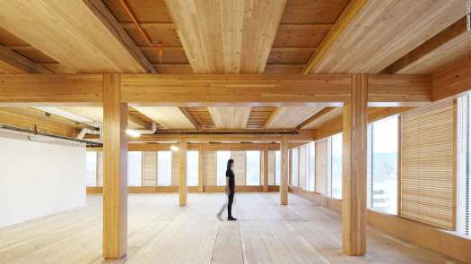
TIMBER
Thousands of years ago, wood was the second most populous and most used material next to the stone.
100% natural material, directly taken from the trees, so no fossil fuels are required to manufacture the material.
nowadays, we recently introduced CLT(cross-laminated timber)
easily processed and these prefabricated panels can be brought to the site and installed efficiently without wasting the material.
cost-effective material and can be easily recycled.

Slide 9
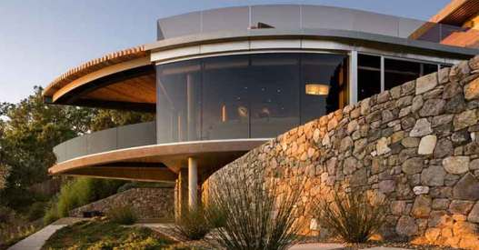
STONE
durable and resistant to weathering, very sustainable and durable
Weatherproof, and consumes less energy for construction and maintenance.
harsh chemicals and wall coatings are not required for stone.
recyclable material and we can use 100% of the stone from old projects by recycling.
.widely available, but expensive to transport

