Slide 1
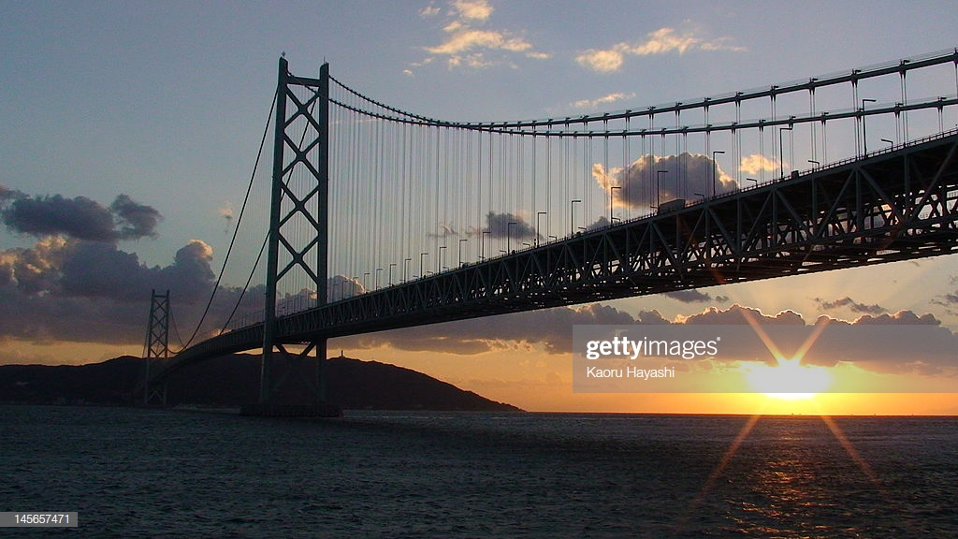
The Akashi Kaikyo bridge

Slide 2
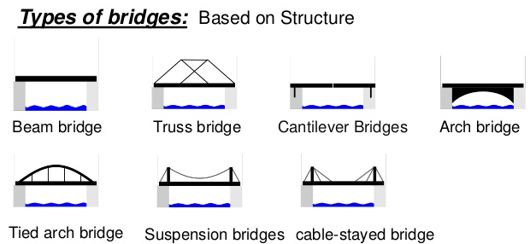
Some basic types of bridges
Beam bridge
Truss bridge
Cantilever bridge
Arch bridge
Suspension bridge

Slide 3
Suspension bridge
typical features:
two main cables suspended from towers,
concrete blocks or anchorages,
roadway/and or railway on smaller vertical
cables

Slide 4
Akashi Kaikyo Bridge (AKB)
Location: between Kobe and Awaji-shima island
Time: 1988 - 1998
Length: 3911 m
Height: 282.8 m (the highest bridge tower)
Longest span: 1991 m (the longest single span)
Materials: steel, reinforced concrete
Cost: 4.3 billion USD (the most expensive)

Slide 5
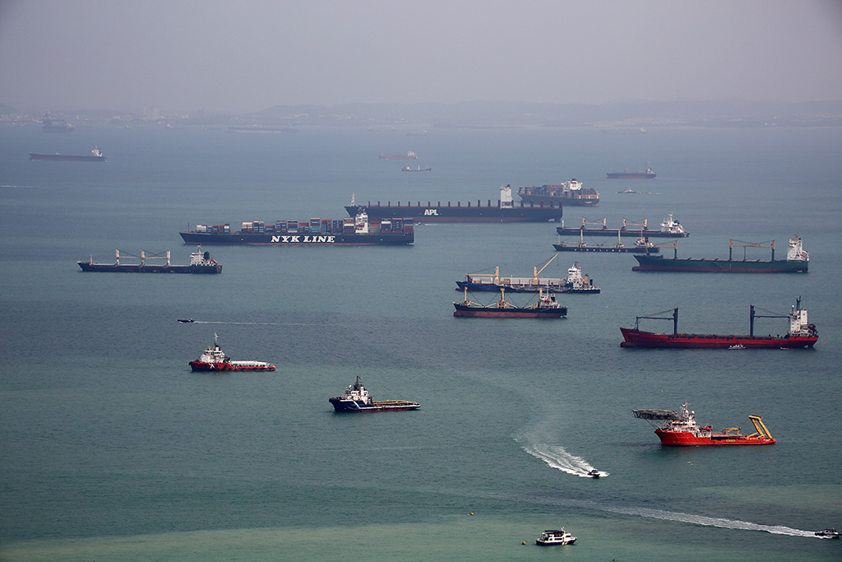
Extreme conditions
frequent earthquakes (potential tsunamis)
strong gale winds, storms and hurricanes
deep water (sea bed deeper than 110m)
heavy shipping traffic,
length of the strait
strong sea currents, heavy rains, dense fogs

Slide 6
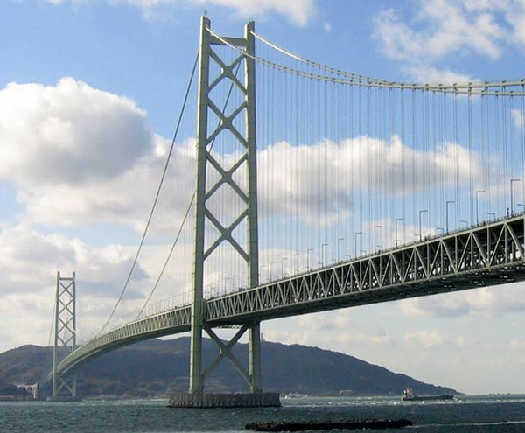
Technological solutions
complex network of steel trusses connected in triangular patterns
a new type of steel wire (flexible, but incredibly strong)
20 mass dampers (to counteract strong winds and compensate for earthquake vibrations

Slide 7
- network of triangular braces - structural design - thickness of the main steel cable - size of a concrete foundation cylinder

Slide 8
Fun facts
more than 300,000 km of steel wire (long enough to circle the Earth 7.5 times)
4 times longer than the Brooklyn bridge
180 mph winds, 8.5 on the Richter scale
during the 8.5 Hanshin earthquake, it extended for 1 meter
23,000 cars per day
each cable is 112 cm in diameter and contains 36,830 strands of wire.^{[5][6]}

Slide 9
Environmental impacts
water pollution
- animal habitat loss
- less food resources
- overcrowding of species at one place
(possible extinction of some species)
noise pollution (caused by construction work and traffic)
air pollution (smog from exhaust pipes, emission of CO2 and NO2)

Slide 10
Modern trends and tendencies
proper management of natural resources to avoid depletion and ensure ecological balance (sustainability)
bridge designs should be smart and efficient and should meet the following criteria:
1) selection of proper materials 2) prevent pollution
3) low maintenance cost
5) biodegradability after abandonment

Slide 11
Some terms and expressions
to support with a truss- poduprijeti rešetkom
complex network of triangular braces- složena mreža trokutastih spona
rigid connection- kruta, čvrsta veza, spoj
damper - amortizer
to sway in the opposite direction- ljuljati u suprotnom smjeru
center span- središnji luk
susceptible to the influence of wind- podložan utjecaju vjetra
bending strength- otpornost na savijanje, savojna čvrstoća
lateral stability – bočna stabilnost
biodegradability – bio-razgradivost

