Slide 1
Three Gorges Dam
The biggest concrete structure in the world

Slide 2
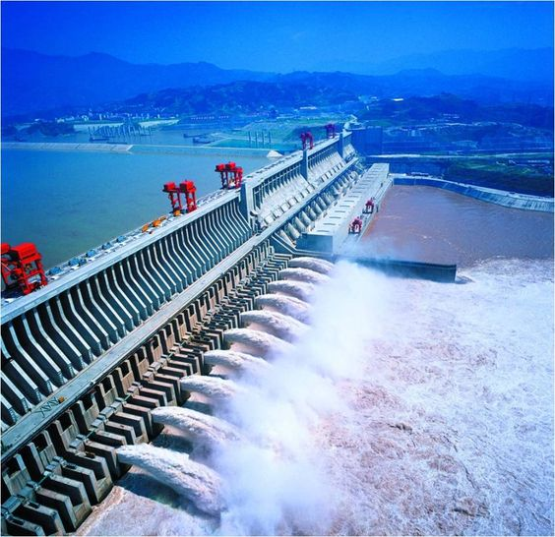
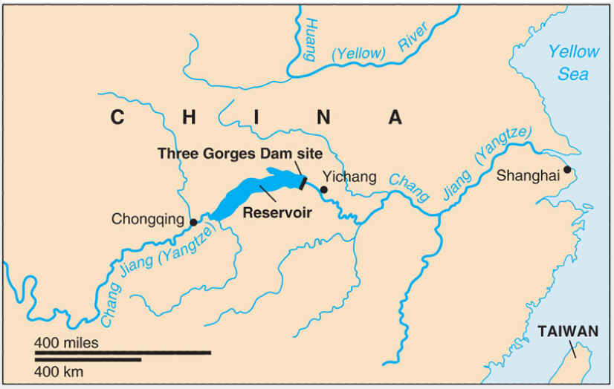

Slide 3
Less known words
Impermeable = nepropusan
Spillway gates = mjesto preljeva brane
Droplets = kapljice
Sluice gate = zaštitna vrata

Slide 4
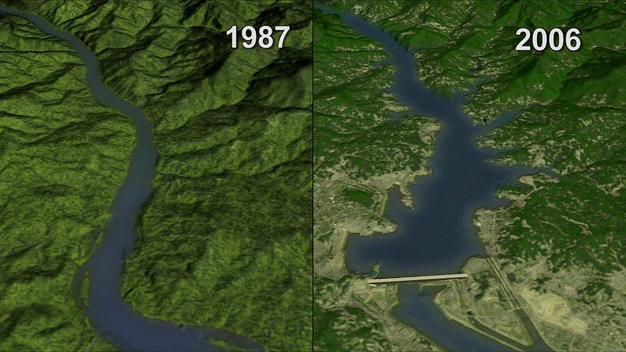
The project
Built on the Yangtze River
Beginning : December 14. 1994.
Length: 2,335m
Height: 181 m
14 thousand
workers
Ending : December
2015.

Slide 5
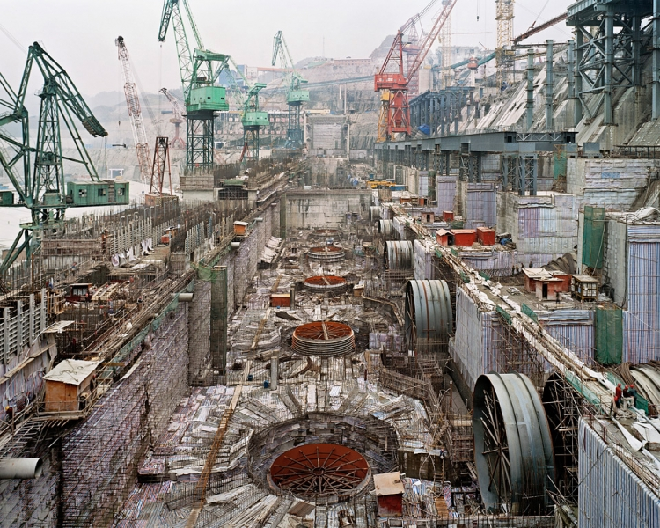
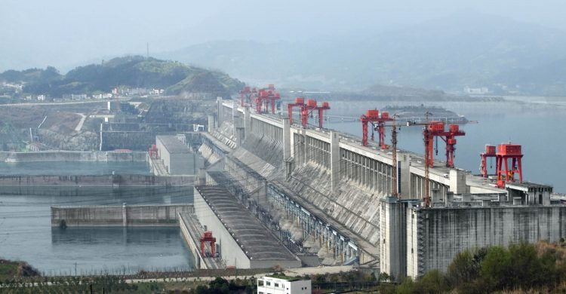

Slide 6
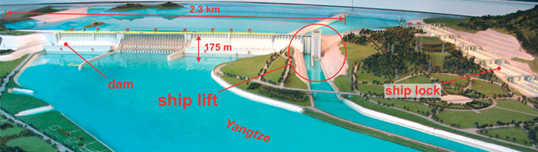
Construction
Two stages
Built by using cofferdams and by diverting the river
Impermeable curtain
The eviction of 3 million people

Slide 7
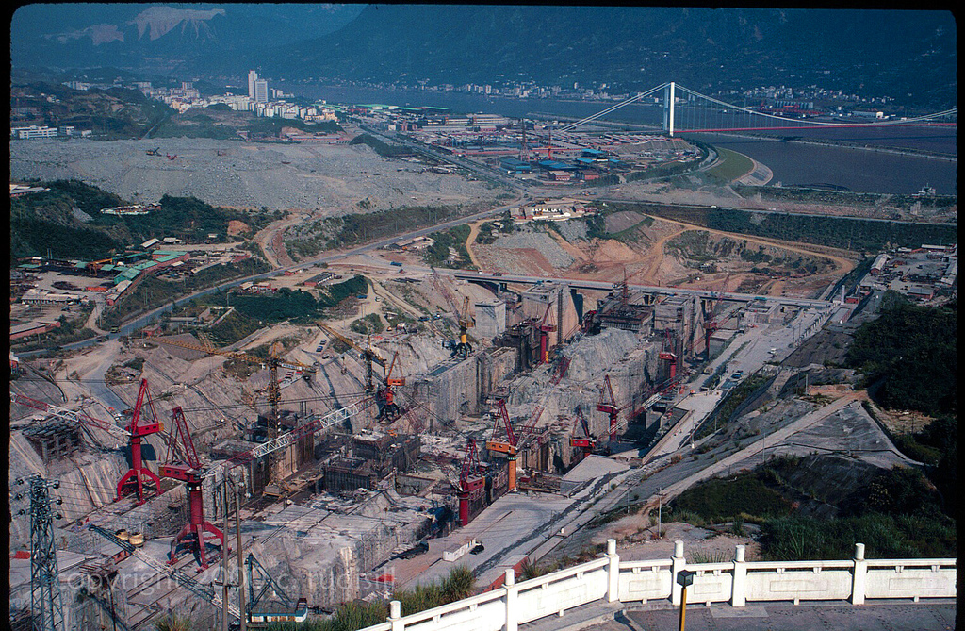
stage one
Stone cofferdams and diversion of the river
Finished two thirds of the main dam
Excavators

Slide 8
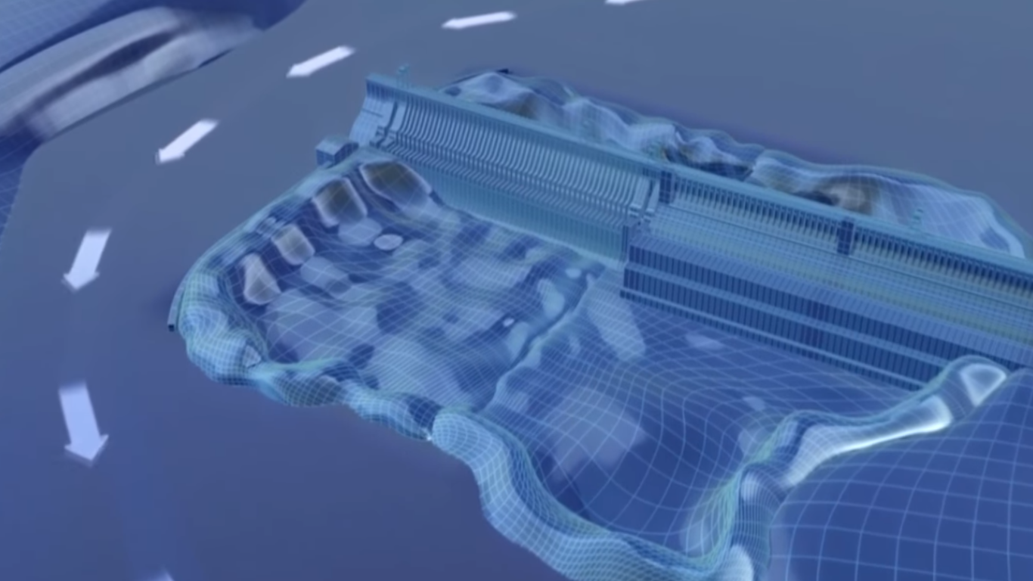

Slide 9
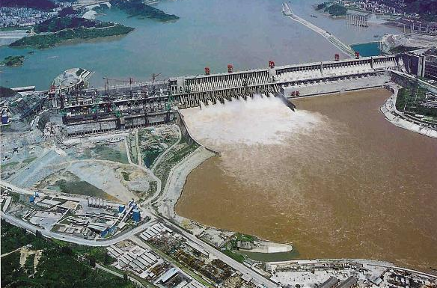
Stage two
Poured concrete over the river bank
Concrete cofferdam
Dynamite

Slide 10
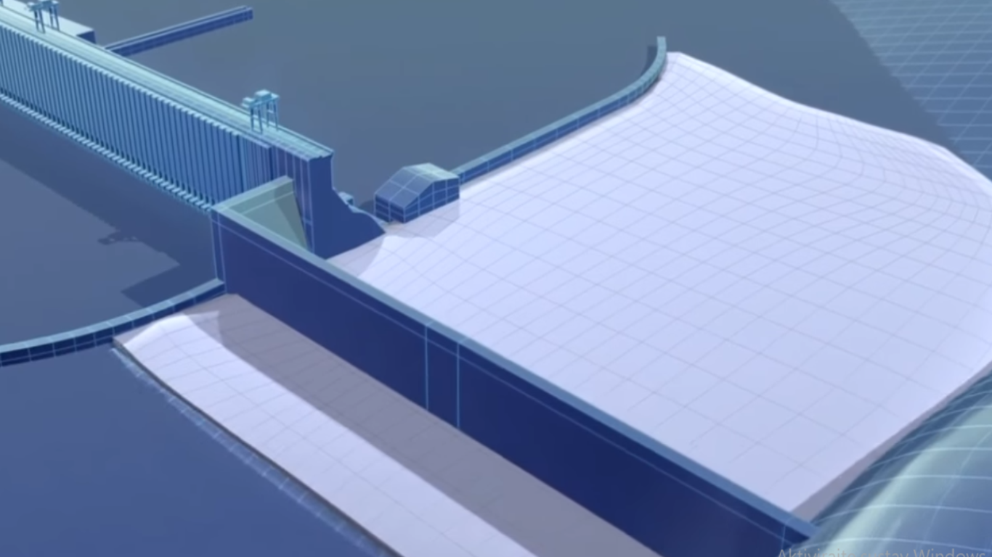

Slide 11
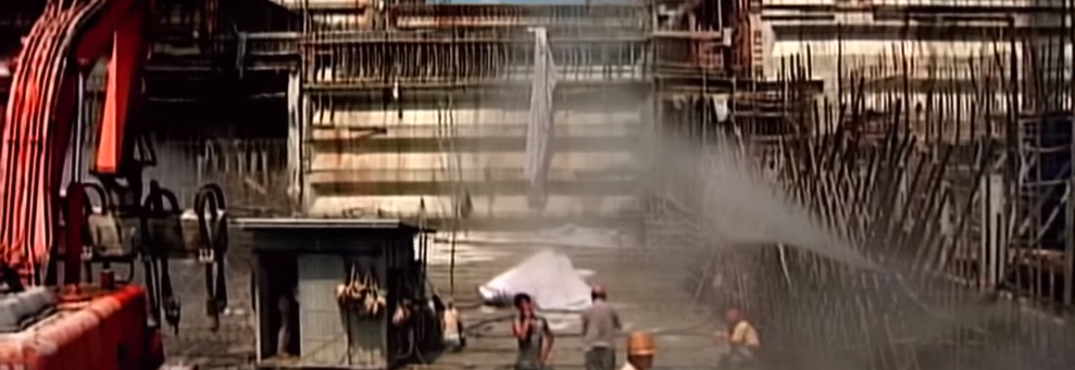
concrete
Heat problem
Cooled aggregates and ice cold water
Fog spray system
28 million m³

Slide 12
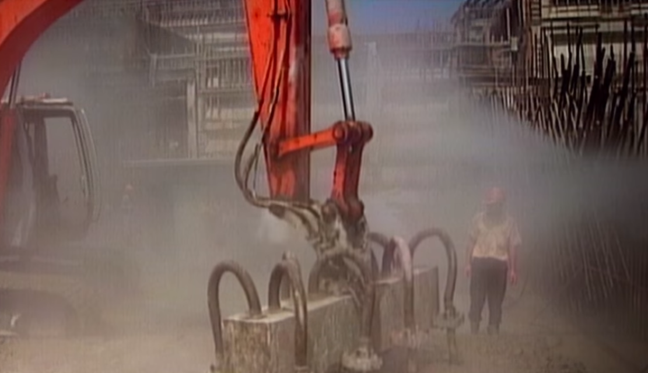
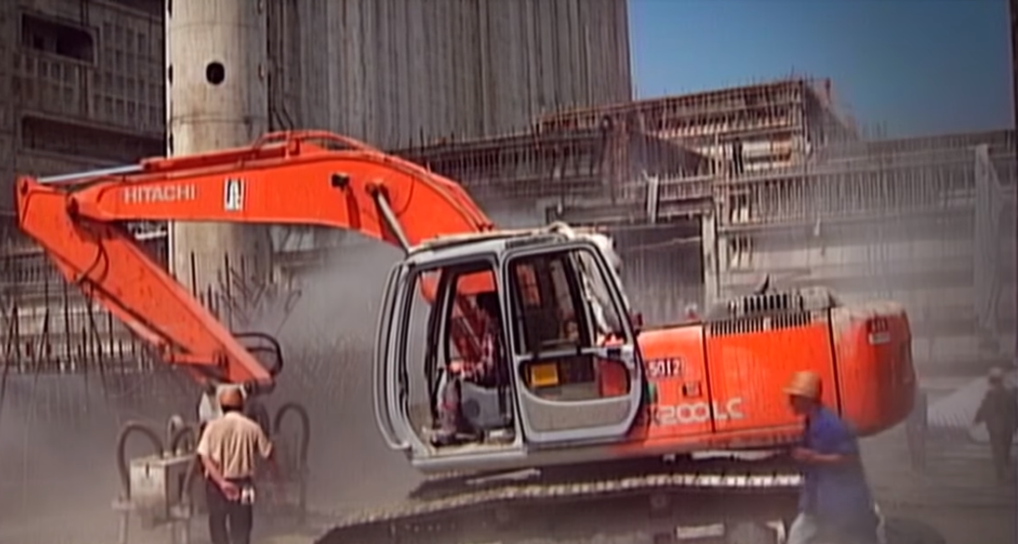

Slide 13
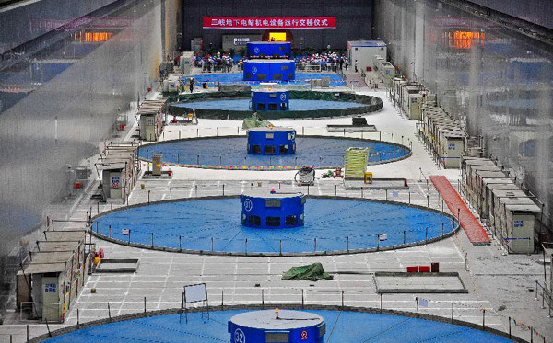
Power generation
3 power houses
14 turbine generators by power house
Concrete tubes
22 500 MW
of power
60 million
Chinese

Slide 14
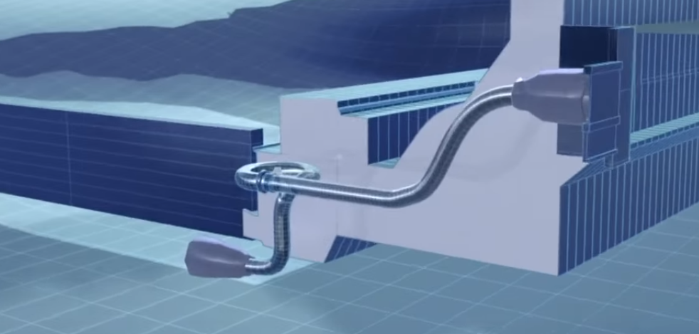
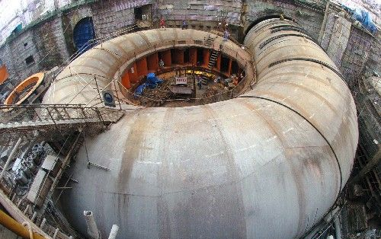
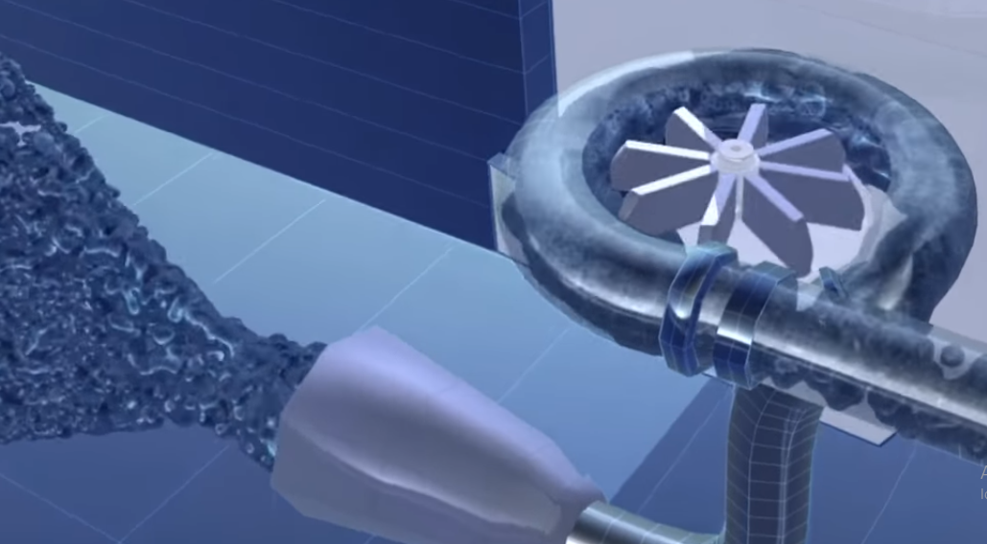

Slide 15
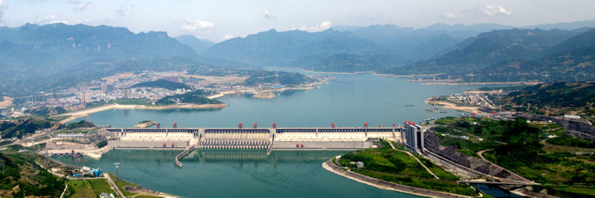
Three Gorges Reservoir
175 m maximum water level
Length: 660 km
Width: 1.12 km on average
Surface: 1045 km²

Slide 16
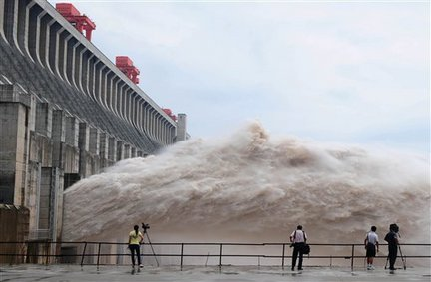
The water
46 spillway gates
Concrete shoes → 100 m
Small droplets
Decrease of
floods

Slide 17
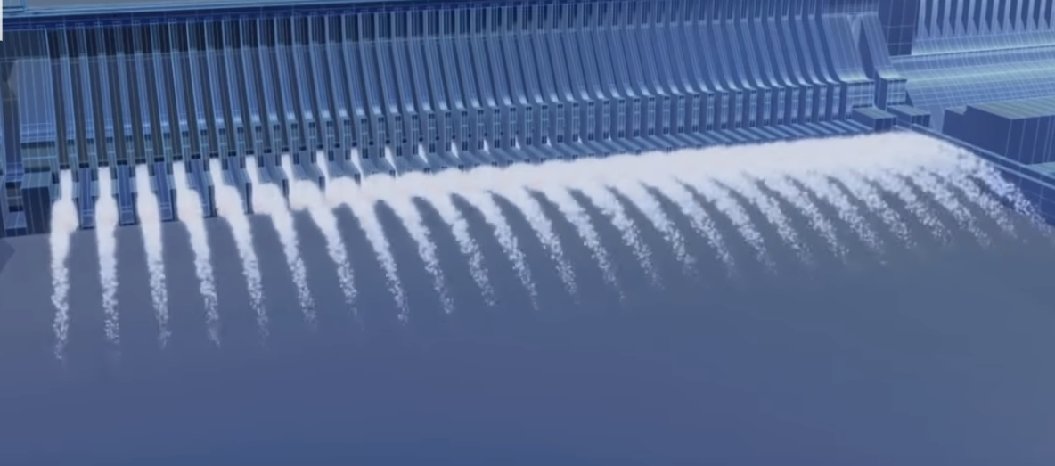
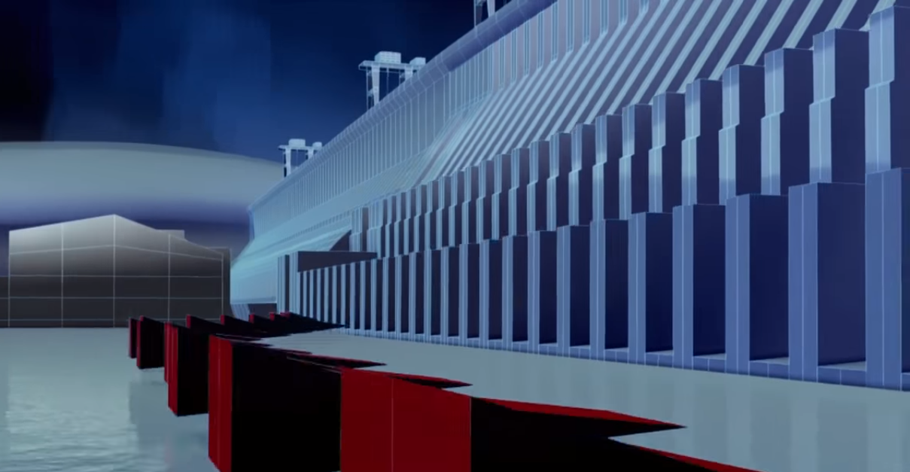

Slide 18
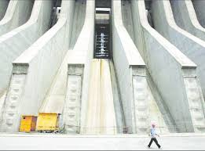
Sediment
Flood water
Sluice gates
100 years before it influences the dam

Slide 19
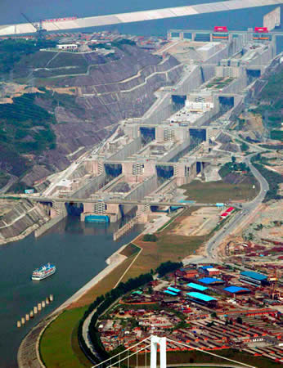
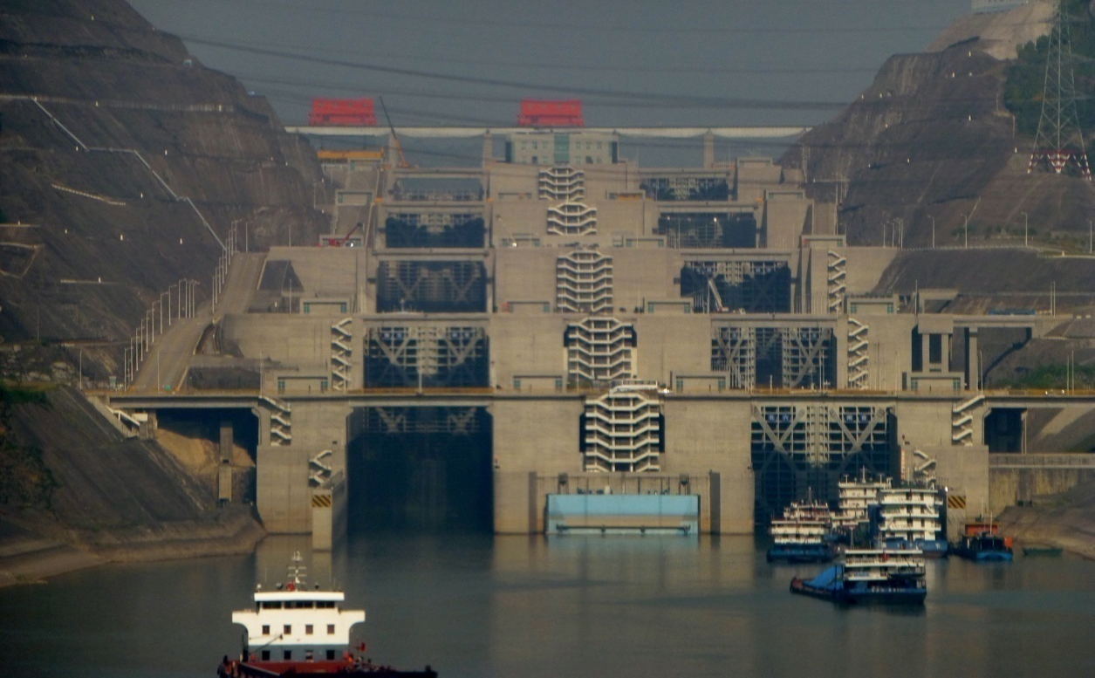
Traffic
15.2 million containers in the 2016.
170 ships per day
Ship lock
Ship lift

Slide 20
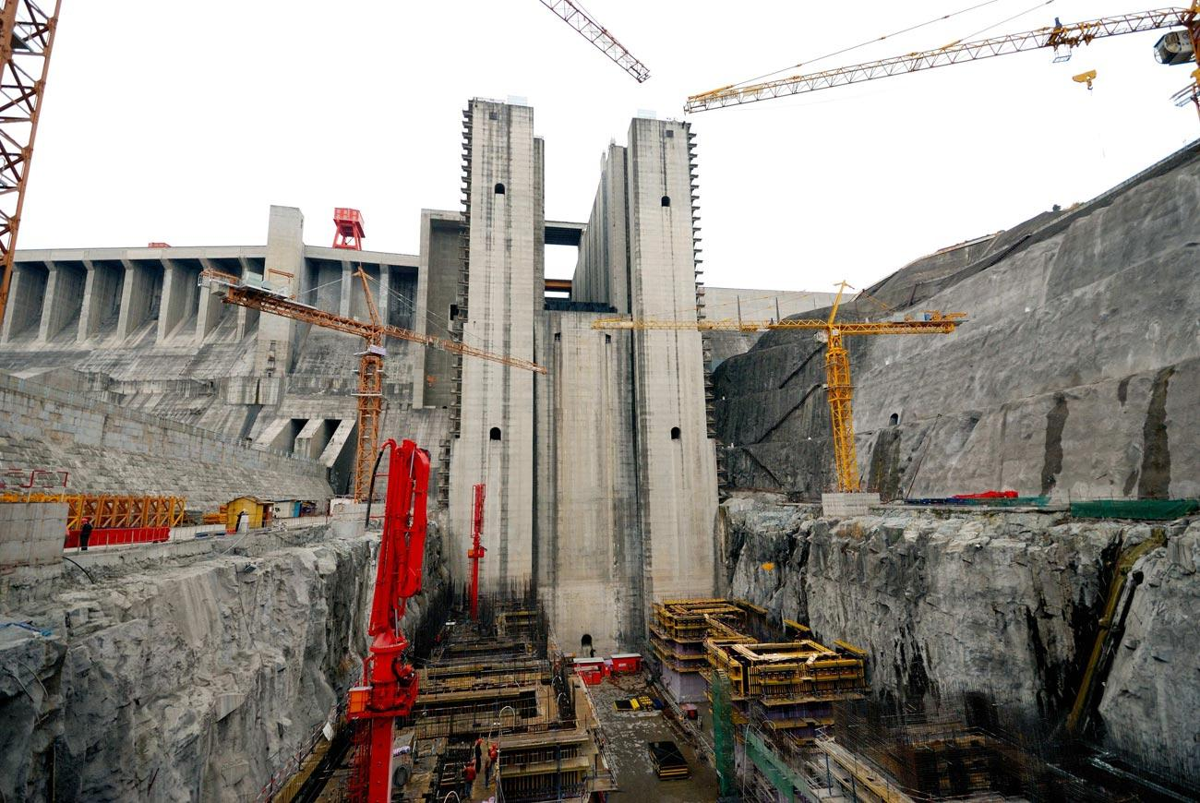
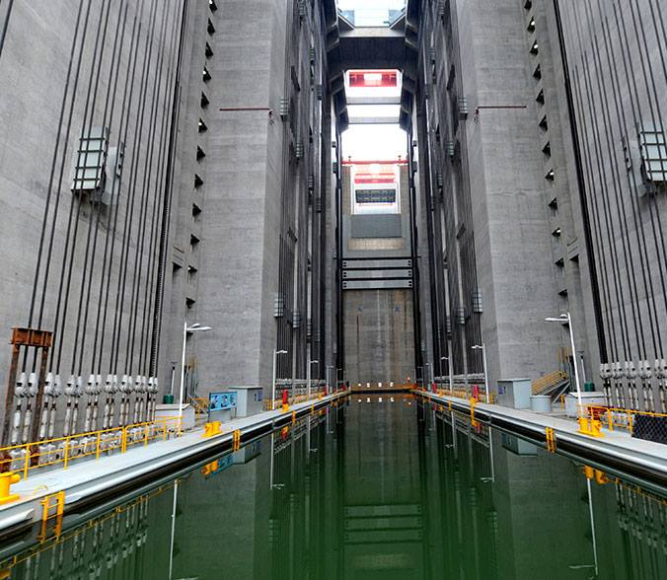
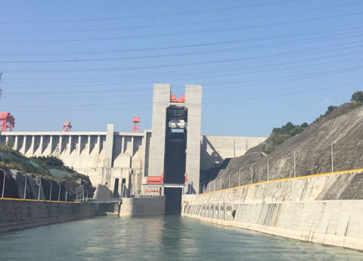

Slide 21
thank you for your attention

