Slide 1
tunnels

Slide 2
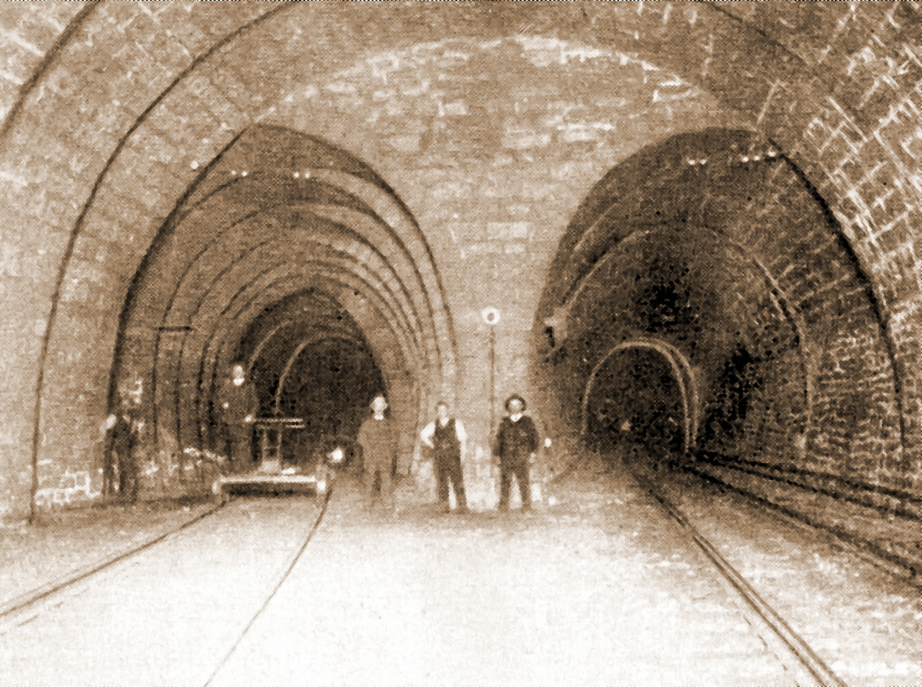

Slide 3
TunnelS - DEFINITION
- UNDERGROUND OR UNDERWATER, ESENTIALLY LINEAR OPENINGS, WHOSE LENGTH GREATLY EXCEEDS THEIR WIDTH AND THAT ARE COMPLETEY ENCLOSED ON ALL SIDES
- an artificial underground passage, especially one built through a hill or under a building, road, or river.

Slide 4
TYPES
TRANSPORTATION TUNNELS ( used by pedestrians, cyclists, motor vehicles, or rail)
A tunnel may also be used for a canal or a flow of water (AQUEDUCT)
UTILITY TUNNELS (SEWAGE)
TUNNELS FOR telecommunication cables or steam pipes,
MILITARY TUNNELS
MINING TUNNELS, ACCESS TUNNELS, DRAFTS
Some tunnels are designed as wildlife crossings, ETC

Slide 5
history
All major ancient civilizations developed tunneling methods
In Babylonia, tunnels for irrigation
a brick-lined pedestrian passage some 3,000 feet (900 metres) long was built about 2180 to 2160 BC under the Euphrates River to connect the royal palace with the temple.

Slide 6
Eupalion tunnel
- 1036 m long tunnel, on Samos Island, Greece, 6th century BC. to serve as an aqueduct
The Tunnel is an engineering feat of outstanding importance:
The tunnel under a mountain was dug dug simultaneously, from two portals diametrically opposite
maths and geometry of outstanding precision to align the excavations before they met
Eupalinos worked as a modern engineer 2500 year ago.

Slide 7
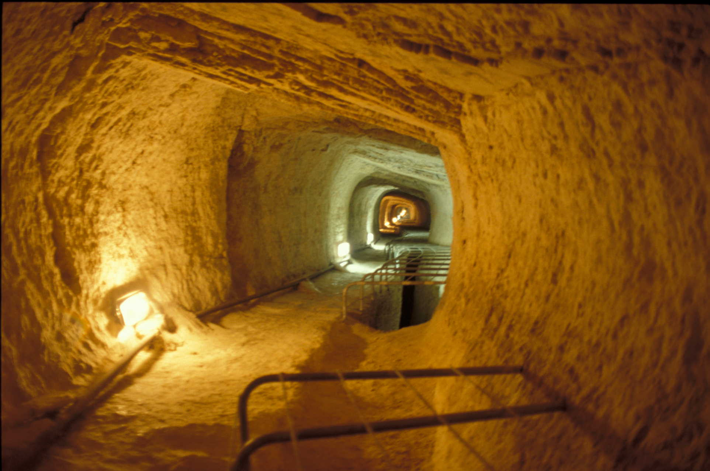
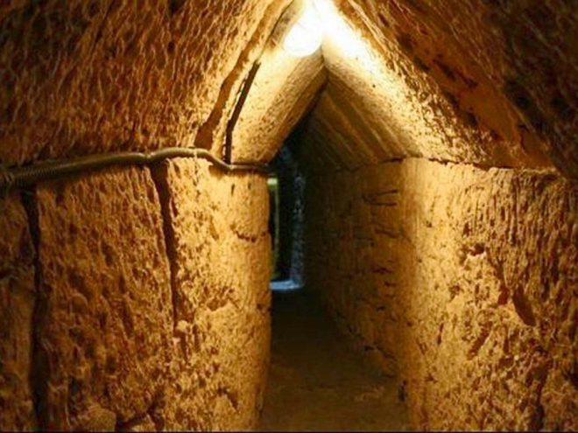

Slide 8
Tunneling methods
Digging (manual work)
Mining/blasting
boring

Slide 9
Tunneling tools and machinery
Digging: BORING: OTHER:
Shovel DRILLS CONVEYOR BELT
SpadE (PNEUMATIC) BORING MACHINES TUNNELING SHIELD
Mattock TBM (TUNNELNG BORING MACHINES) LASER
PicK

Slide 10
TBM
A tunnel boring machine, also known as a "mole", is a CUSTOM-MADE machine used to excavate AT ONCE THE TOTAL DIAMETER OF A SPECIFIC tunnels
They can bore through anything from hard rock to sand. Tunnel diameters can range from one metre (done with micro-TBMs) to 17.6 metres
TBm’s are used as an alternative to drilling and blasting (D&B) methods
Advantage: fast, safe, efficient, neat, disadvantage: cost

Slide 11
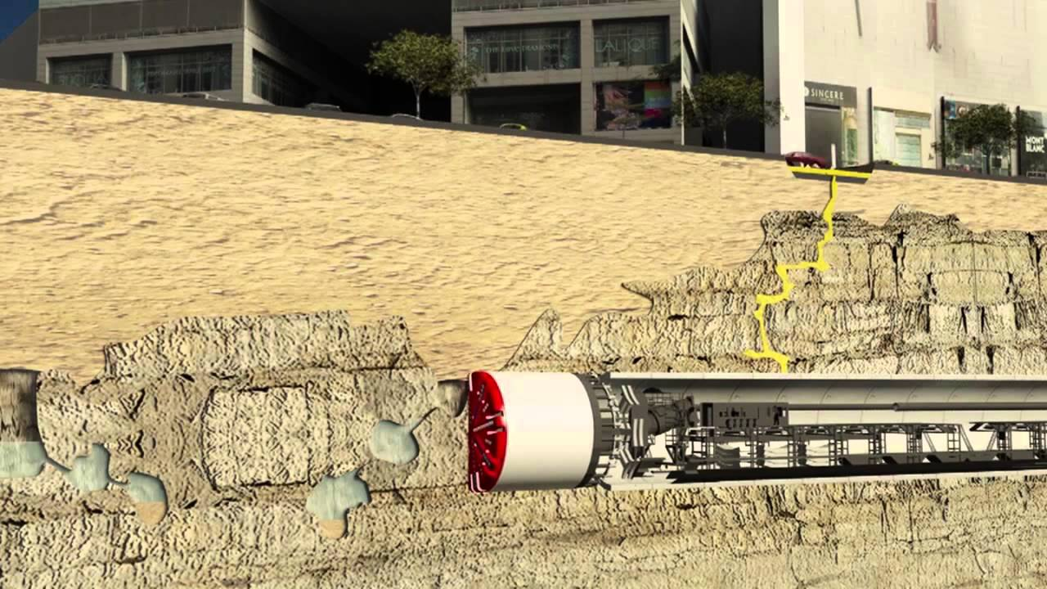

Slide 12
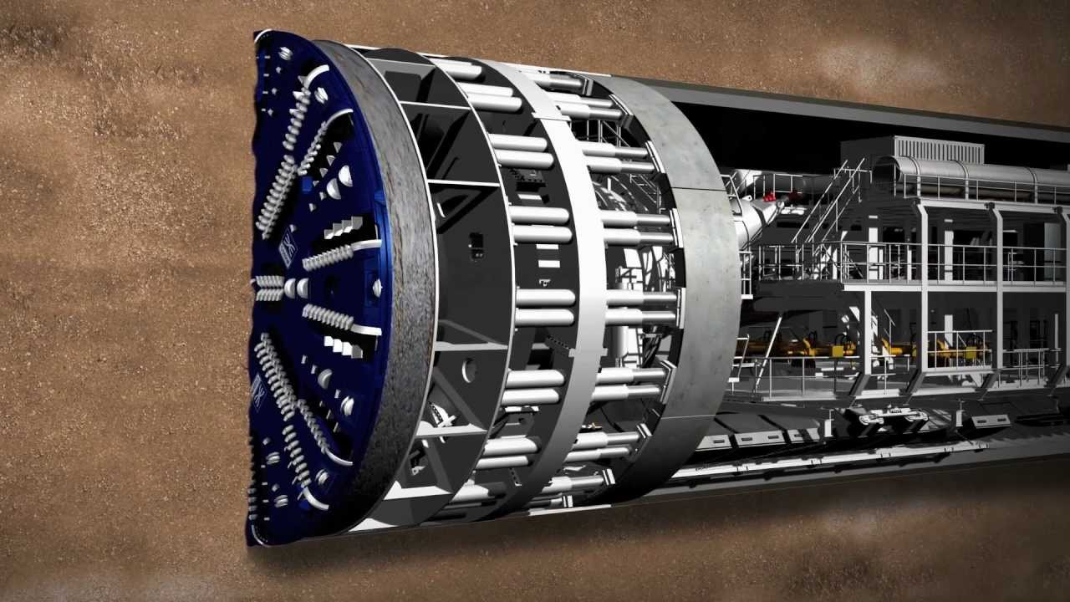

Slide 13
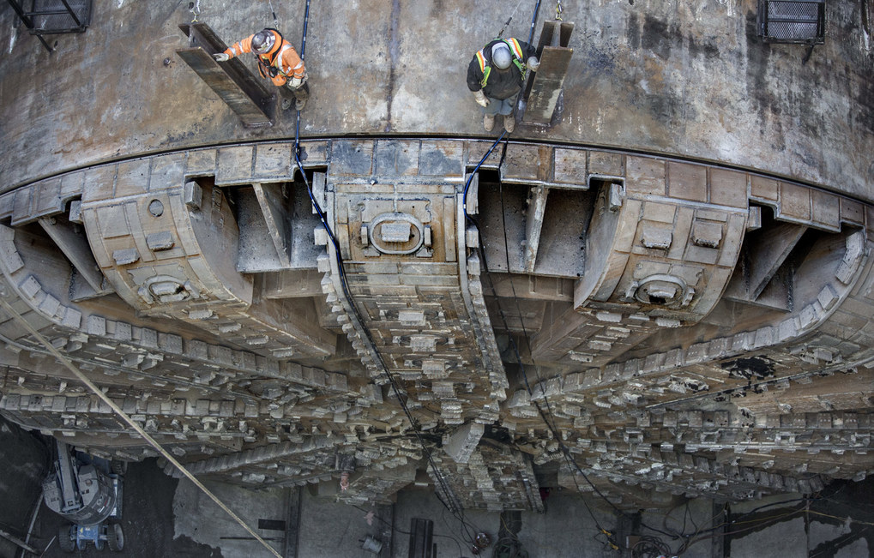

Slide 14
THE MOST FAMOUS
The Seikan Tunnel in Japan is the longest rail tunnel in the world at 53.9 kilometers, of which 23.3 kilometers is under the sea.
The Channel Tunnel between France and England under the English Channel is the second-longest, with a total length of 50 kilometers, of which 39 kilometers is under the sea.
The St. Gotthard Tunnel IN Switzerland is the world's DEEPEST TUNEL (2, 3 KM) IN THE WORLD AND second longest highway tunnel at 16.32 kilometers.

