Slide 1
WHAT IS GREEN BUILDING?
SOME BASIC CONCEPTS

Slide 2
Green buildings are designed to reduce the overall impact of the built environment on human health and natural environment by:
Efficiently using energy, water and other resources.
Protecting occupant’s health and improving employee productivity.
Reducing waste, pollution and environment degradation.

Slide 3
These are buildings that ensure that:
waste is minimized at every construction stage
building and maintenance costs are minimized, and

Slide 4
Following examples can be considered for green buildings:
green buildings may incorporate sustainable materials in their construction (e.g., reused, recycled content, or made from renewable resources).
create healthy indoor environments with minimal pollutants (e.g., reduced product emissions).
feature landscaping that reduce water usage (e.g., by using native plants that survive without extra watering).
a green building is a structure that is environmentally responsible and resource-efficient throughout its life-cycle. These objectives expand and complement the classical building design concerns of economy, utility. Durability and comfort.

Slide 5
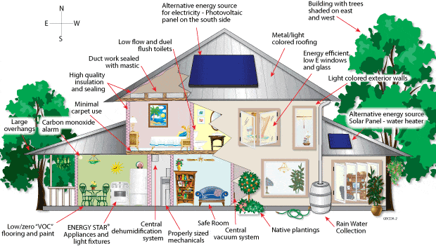

Slide 6
What are Green Features of a Green Building?
Minimal disturbance to landscapes and site condition
Use of non-toxic and recycled / recyclable material
Efficient use of water and water recycling
Use of energy efficient and eco-friendly equipments
Use of renewable energy
Quality of indoor air quality for human safety and comfort
Effective controls and building management systems

